Slide 1
White Salmon Comprehensive Plan Update
Planning Commission/City Council Workshop
Scott Keillor & Ethan Spoo, WSP

Slide 2
Introduction
Purpose:
Modernize the comprehensive plan
Foundational vision
Consistency between elements
Updated data, context, and style
Why is the comprehensive plan important?
Provides direction on how the community will grow
Provides policy direction for future development code updates

Slide 3
Comprehensive Plan Organization
Current Plan (2012)
Mission Statement Public Officials Executive Summary 1. Introduction 2. History Element 3. Historical Sites and Structures Element 4. Parks and Recreation Element 5. Economics Element 6. Environmental Quality Element 7. Transportation Element 8. Public Facilities and Services Element | 9. Housing/Populations Projections Element 10. Urbanization Element 11. Land Use Element 12. Resource Land Element 13. Critical Areas Element 14. Wildfire Element 15. Issues Element 16. Administration Element 17. Capital Improvements Element Appendix A. Maps B. Agreements

Slide 4
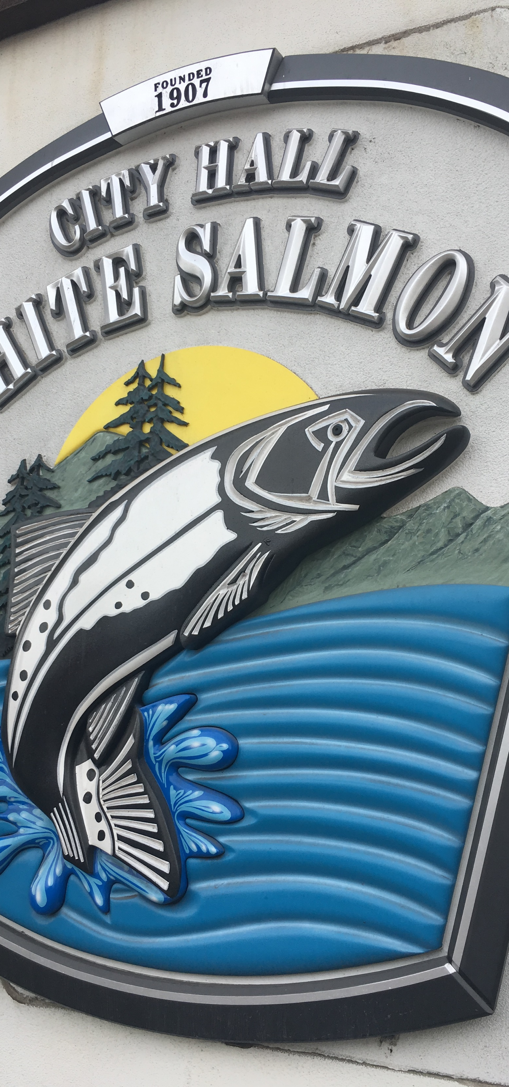
Comprehensive Plan Organization
Updated Plan (2021)
Acknowledgments Vision 1. Introduction and Community Profile 2. History and Historical Places 3. Parks and Recreation 4. Economic Development 5. Environment and Critical Areas 6. Transportation 7. Public Facilities and Services 8. Land Use and Urbanization 9. Housing 10. Capital Improvements | Appendices A. Historic Resources B. Urbanization Study C. Parks and Recreation Plan D. Transportation Plan E. Capital Facilities/Improvement Plan F. Sewer Plan G. Water Plan

Slide 5
Plan elements
Vision and Focus Area Statement for key elements
Background
Existing Conditions
Existing Plans and Regulations
Goals and Policies

Slide 6
Public Involvement
Community Outreach/Events
Community survey (159 responses received)
Community conversations (350 comments)
Farmers’ market
Movies in the Park
Rotary Club
Klickitat County Senior Center
Everybody’s Brewing
Planning Commission/City Council Meetings/Workshops
32 Planning Commission meetings/workshops
City Council meetings/workshops

Slide 7
2040 Vision
Public involvement activities informed the creation of the vision. The vision helped drive the update of the comprehensive plan and provided a framework for the goals/policies of the elements contained in the plan.
“In 2040, White Salmon is a thriving village bounded by mountains, rivers and the Columbia River Gorge National Scenic Area. We nurture innovation and diversity, creating opportunities and partnerships that foster a prosperous community. Our unique location affords residents and visitors a gateway to explore the surrounding natural beauty. The city offers small streets and pedestrian paths that allow residents to walk to a variety of destinations, interact regularly with neighbors, and support a vibrant downtown business district. Our quality of life is based on balanced and sustainable growth that contributes to the community’s authenticity and prosperity.”

Slide 8
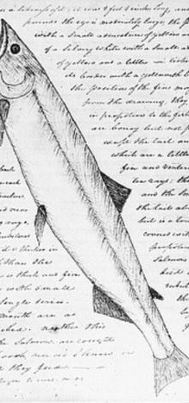
History and Historic Places Goals
Goal H&HP-1. Identify and document historic and cultural resources within the White Salmon urban area.
Goal H&HP-2. Encourage and promote private, public, and tribal parties to support the city’s archaeological, historical, and cultural goals and objectives.
Goal H&HP-3. Recognize the importance of educational materials and programming to stimulate awareness of the role that preservation and promotion of historic resources play in the city’s future.
Goal H&PP-4. Consider historic and cultural resource sites and values into city plans where appropriate.
Goal H&P-5. Maintain and preserve public locations of historical and cultural significance that are listed on local and state historic registers.
Goal H&P-6. Encourage private property owners with locations of historical and cultural significance to maintain and preserve historic and cultural resources.

Slide 9
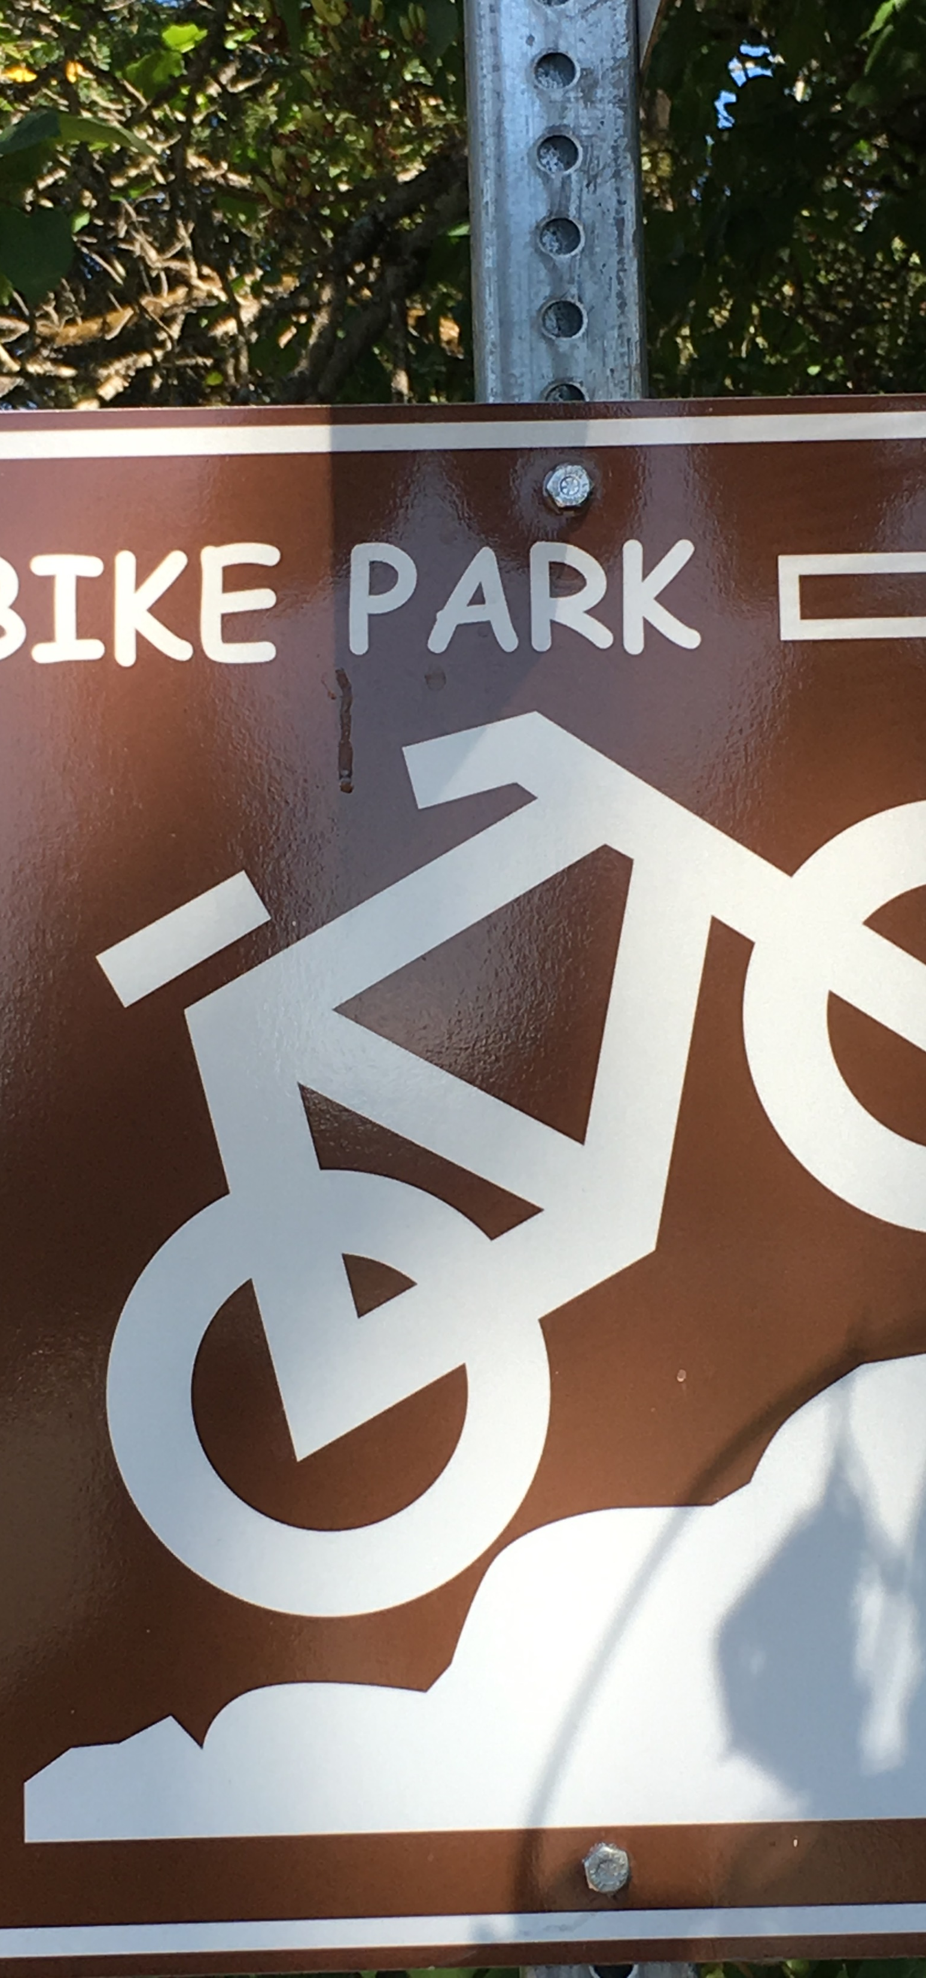
Parks and Recreation Goals
Goal P&R-1. Maintain and improve access and multimodal circulation between park and recreation facilities.
Goal P&R-2. Maintain existing park and recreation facilities and improve existing park and recreation facilities with new or improved facilities, amenities, and uses.
Goal P&R-3. Ensure adequate funding opportunities, coordination, and partnerships to meet current and future park and recreation facility demands and maintenance needs.

Slide 10
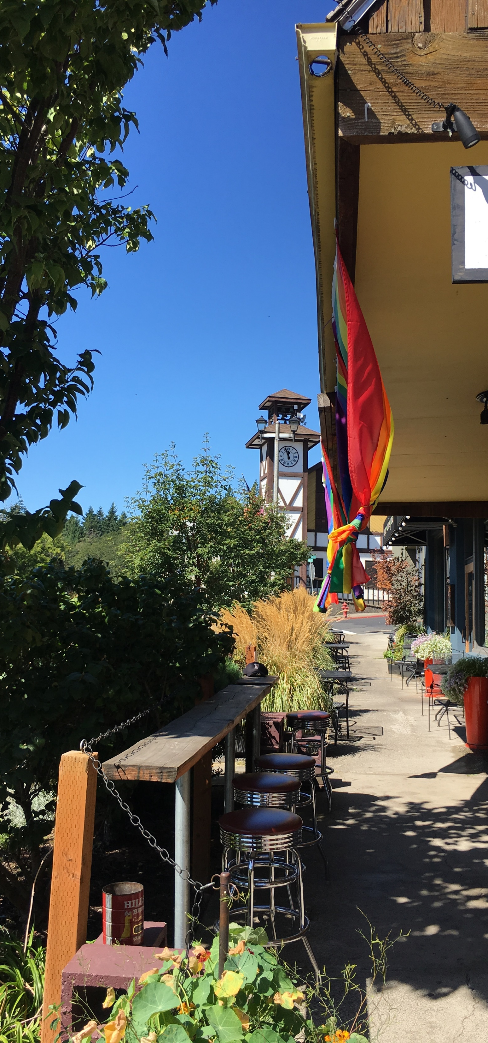
Economic Development Goals
Goal EC-1. Create a distinctive downtown along Jewett Boulevard that is an attractive place to walk, dine, shop, and gather.
Goal EC-2. Support and expand on a robust tourism industry by capitalizing on the scenic beauty and close proximity to recreational opportunities that White Salmon offers.
Goal EC-3. Create an environment that is supportive of existing businesses and does not create unnecessary barriers for their growth.
Goal EC-4. Attract, plan for, and support new businesses and industries in White Salmon.
Goal EC-5. Work with regional economic development partners to foster workforce development programs that support local businesses and provide residents with the training they need to work in family-wage industries.

Slide 11
Environment and Critical Areas Goals
Goal E/CA-1. Protect, maintain, and improve the environmental quality of White Salmon.
Goal E/CA-2. Identify, protect, restore, and enhance White Salmon’s critical areas to preserve their social and ecological functions, ensure public safety, and prevent loss of private property.
Goal E/CA-3. Reduce hazard fuels throughout the City and its Urban Exempt Area to a level that supports fire departments to prevent injury or death to people and to reduce property damage.
Goal E/CA-4. Address climate change by working towards reducing greenhouse gas emissions, increasing energy efficiency, and improving infrastructure resiliency in White Salmon.

Slide 12
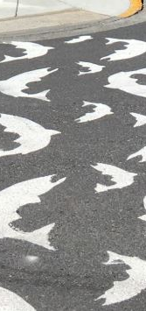
Transportation Goals
Goal T-1. To provide a safe, efficient, and economic transportation network.
Goal T-2. To provide safe pedestrian walkways and bicycle routes while maintaining arterial commercial and residential access via public streets.

Slide 13
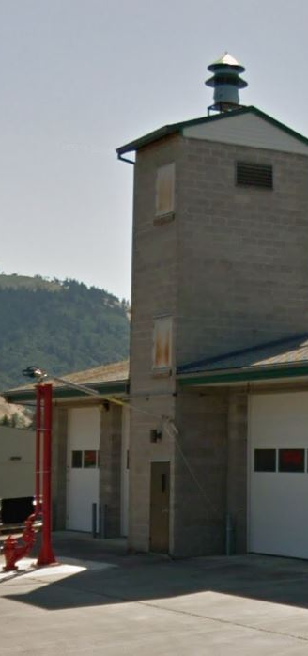
Public Facilities and Services Goal
Goal PF-1. To maintain a balance between growth and services.

Slide 14
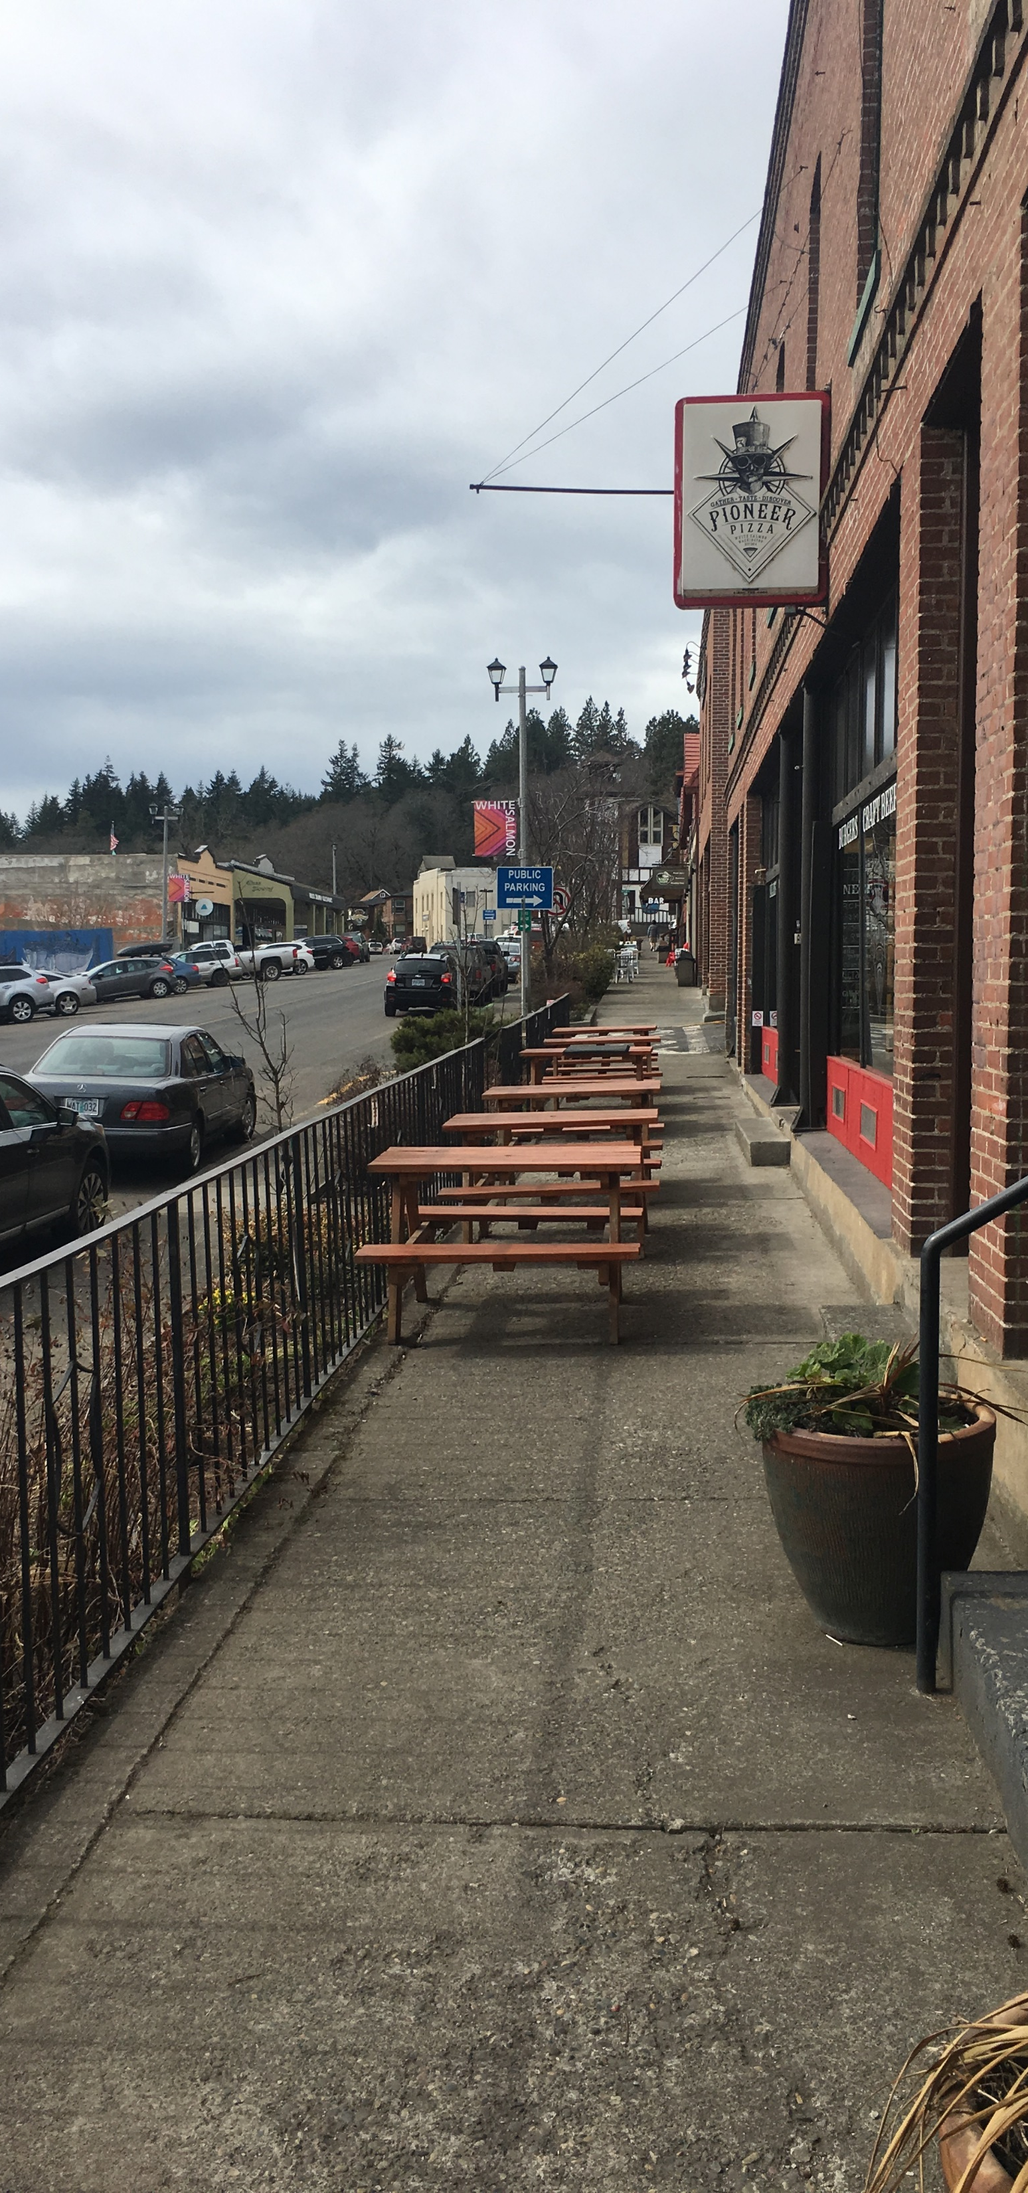
Land Use and Urbanization Goals
Goal LU-1. Establish and maintain a land use pattern that accommodates the current and future needs of the City and provides housing and employment choices that are cohesive with the community’s vision.
Goal LU-2. Collaborate with Klickitat County on land use planning for the Urban Exempt Area, ensuring a common vision for development, orderly land division and infrastructure provision, and the ability to accommodate future residential and employment needs.
Goal LU-3. Establish and maintain design and aesthetic standards that preserve and enhance White Salmon’s “sense of place,” ensuring an objective level of site and building design and construction quality without eliminating or overly limiting creativity and flexibility.

Slide 15
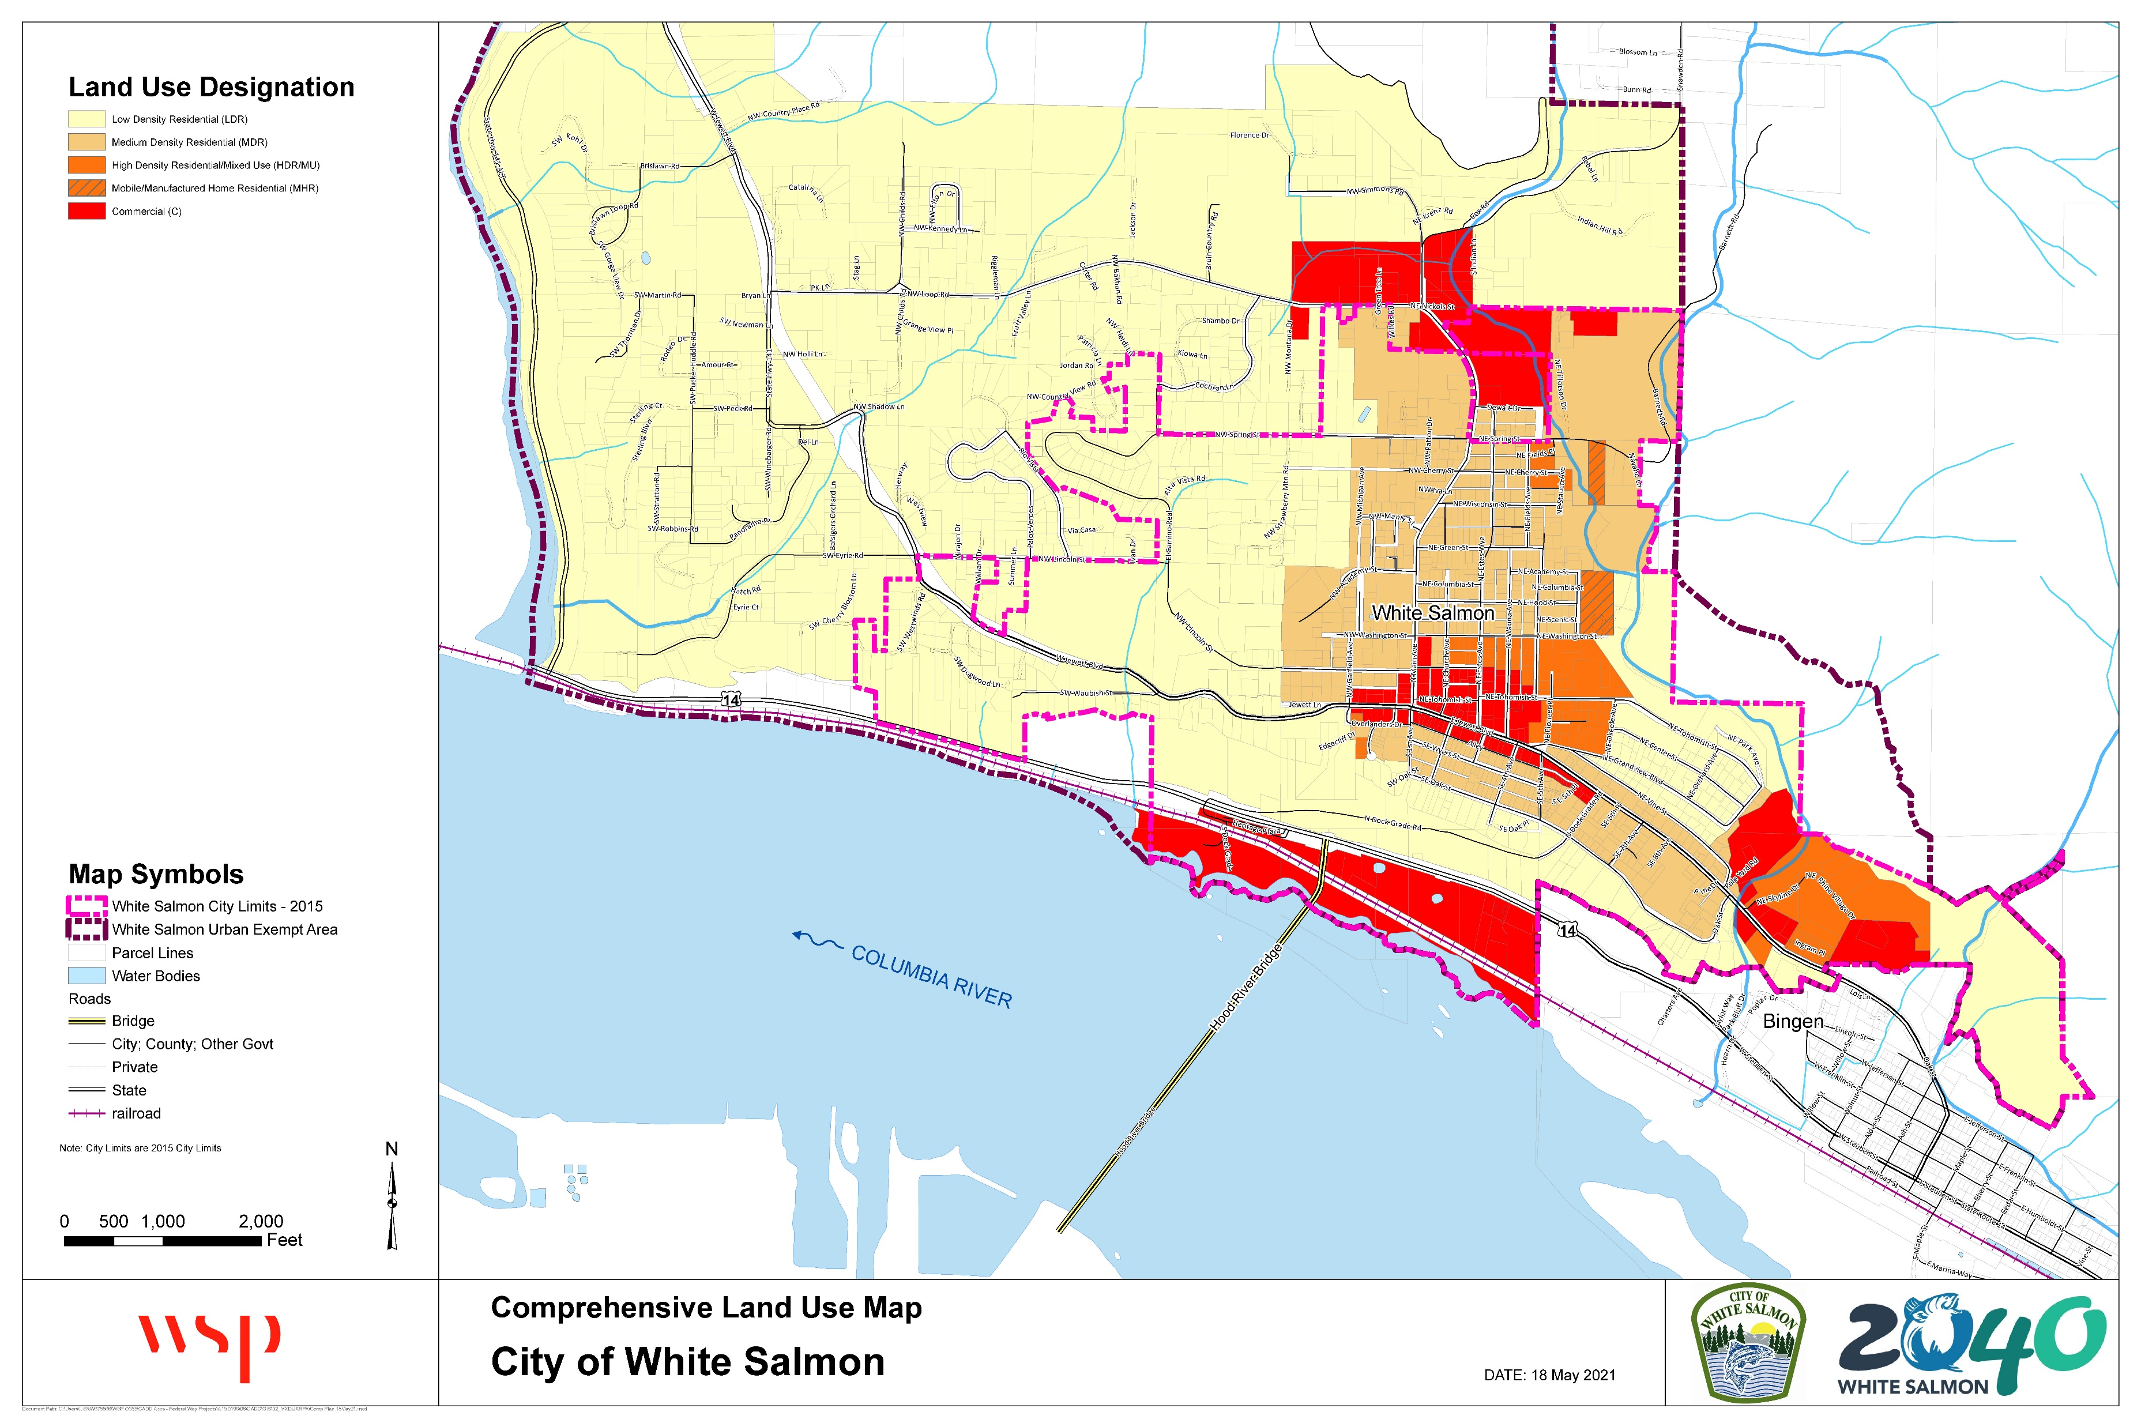
Land Use Designations

Slide 16
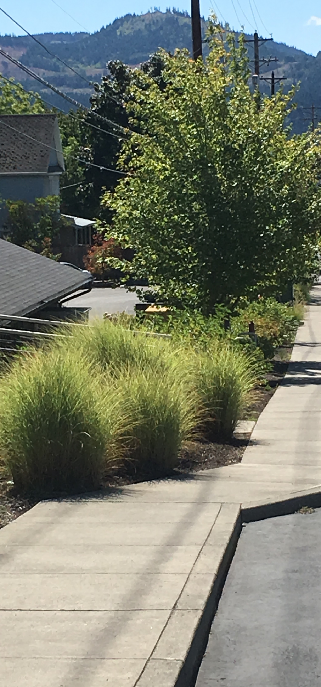
Housing Goals
Goal H-1. Establish, support and maintain a diverse stock of housing that serves the full range of ages, incomes and household types, including long-term renters and people with special needs.
Goal H-2. Establish, support and maintain defined neighborhoods with homes that meet development code standards and enhance the quality of life for city residents.
Goal H-3. Invest in local and regional partnerships for education and data collection to ensure supportive policies and structures are in place that promote housing affordability.

Slide 17
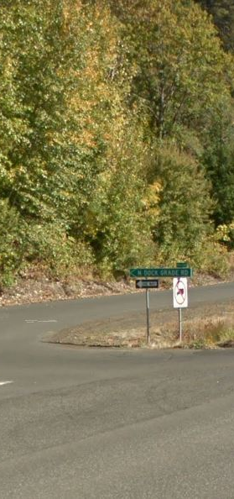
Capital Improvement Program Goal
Goal CIP-1. Coordinate capital improvement planning with land use planning, considering timeframe, funding and improvement demand.

Slide 18
Questions?
For more information contact:
Jan Brending, Clerk/Treasurer
509-493-1133 x205
janb@ci.white-salmon.wa.us

