Slide 1
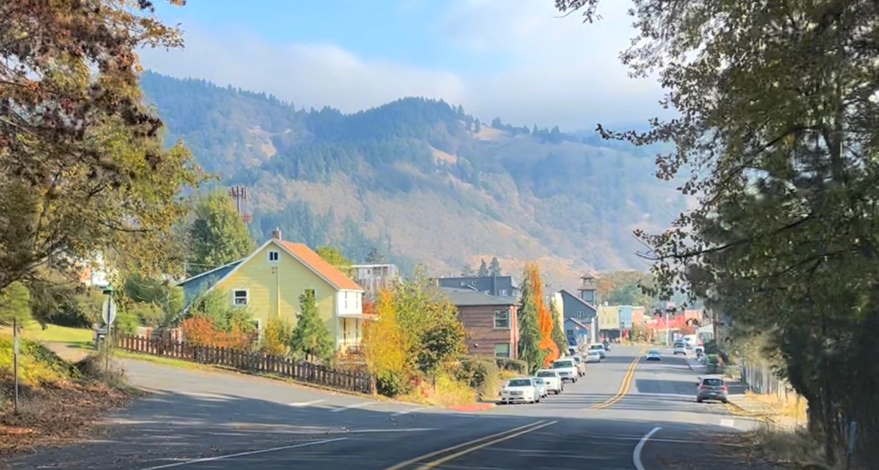
City of White Salmon
Housing Needs Assessment +
Housing Action Plan
City Council and Planning Commission Workshop
June 15, 2023

Slide 2
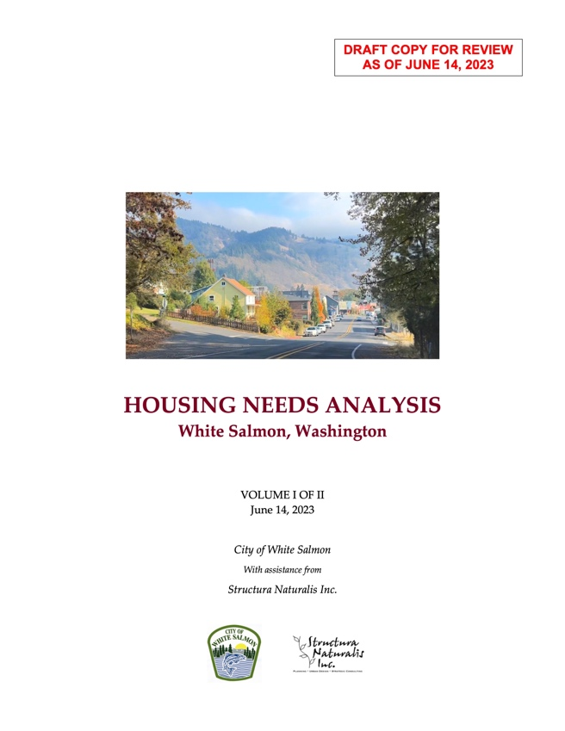
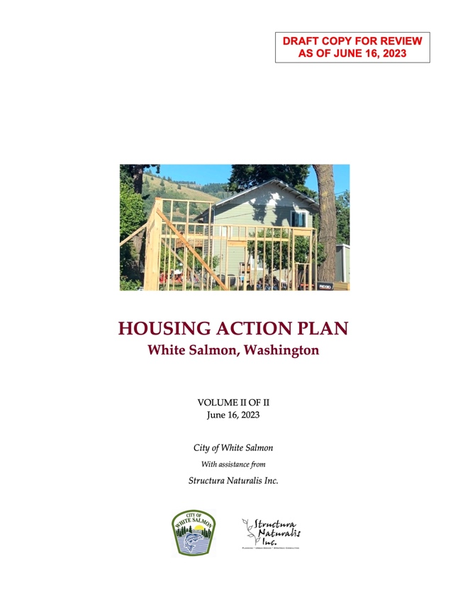
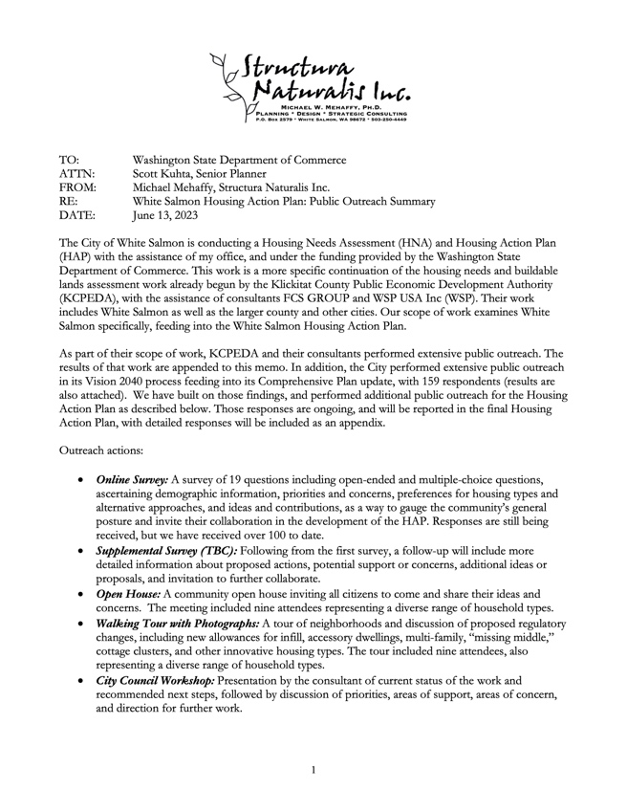
Deliverables This Phase:
Not the end of the process!

Slide 3
This Phase: Housing Needs Analysis, Housing Action Plan, Outreach Summary (Deliverables to funder Washing State Department of Commerce)
NEXT PHASE: Implementation, select and enact ordinances, take other actions as decided.

Slide 4
Agenda
Report on findings of the Housing Needs Analysis
Discussion
Report on results (to date) of community outreach
Discussion
Report on recommendations of the Housing Action Plan
Discussion
Additional ideas and feedback

Slide 5
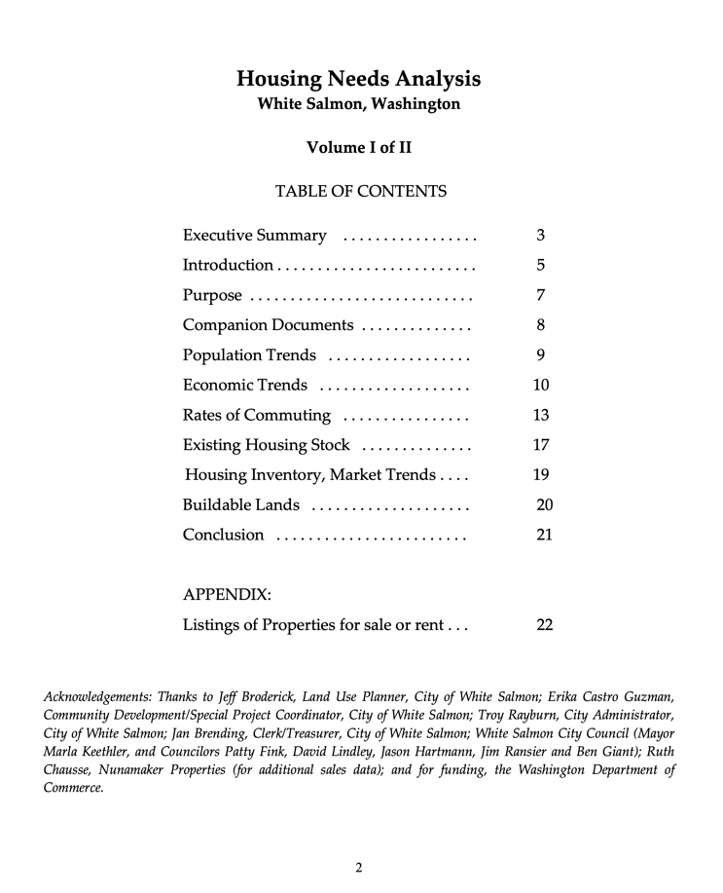
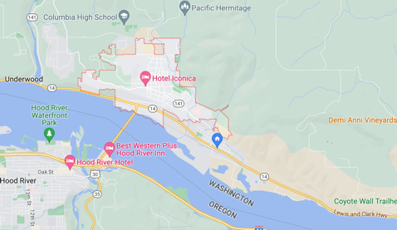
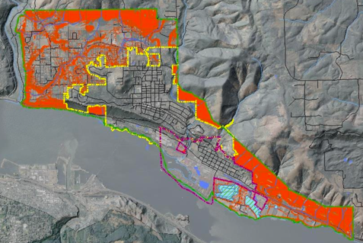
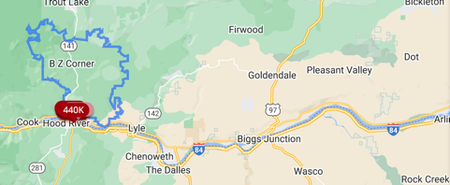
Housing Needs Analysis
NOTE distinction between White Salmon city limits, and other areas of county
(City limits)
(“Urban exempt”)
(Market area)

Slide 6
Current Situation
Current housing inventory is woefully limited - just six homes for sale within city limits, average listing price of $917,500 (3 SFD 3 SFA); eight rental properties, average monthly rental of $2,418 (4-1BR, 3-2BR, 2-3BR).
In the larger county area, 14 homes listed at an average price of $1.22 million; the lowest priced home was $550,000.
Zillow.com estimates monthly payment (PITI) for this lowest-priced home at $3,280. At typical 28% of gross monthly earnings, would require an annual income of $140,500 – far above area median household income of $65,781 (2020 data).
AMI rental at 28% (below rent-burdened) would be $1,534 (not including utilities).

Slide 7
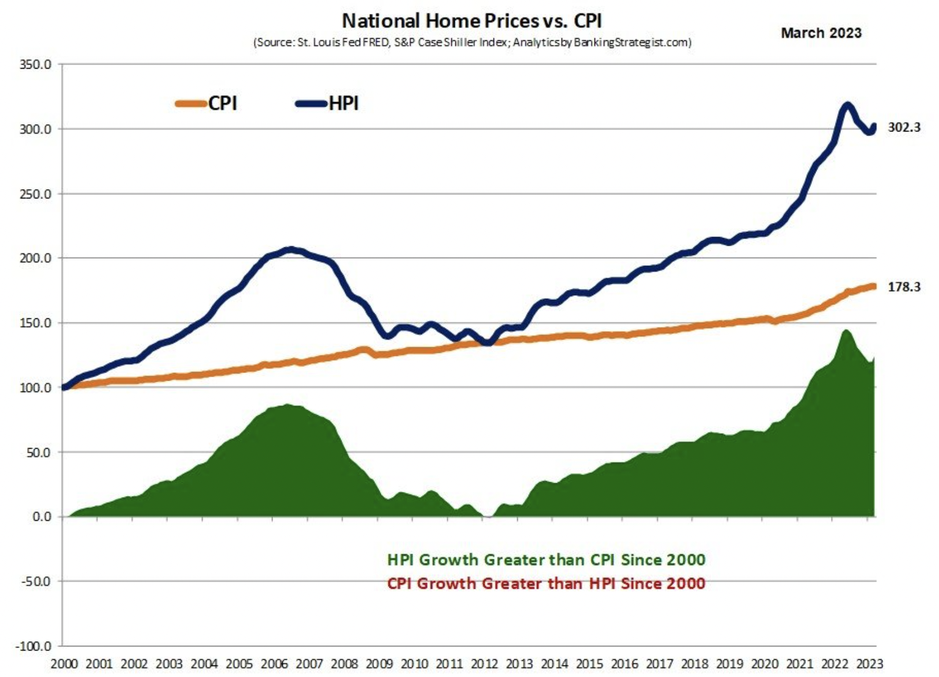
Current Situation (A National Problem)

Slide 8
Current Situation
There is not only a shortage of homes putting upward pressure on prices, but a mismatch of home types and sizes to needs.
There is a growing unmet need for workforce housing, for young people who would like to stay in White Salmon, and for a range of other incomes and lifestyles
There is an over-concentration of single-family detached, typically larger homes at higher prices (69%), which better serve wealthier buyers often from out of the area
Many White Salmon employees commute from long distances, while residents also often commute or telecommute outward (typically to higher-income jobs)

Slide 9
Growth Trends
Growth has been historically slow, about 1.1% per year (accelerating slightly in recent years)
Based on historical growth, WS would add 667 persons by 2043, or about 277 homes (2.41 persons per household)
Growth could be higher – but would require more homes (chicken-and-egg problem). Achieving affordability and diversity would require more than just additional supply.
2020 urbanization study estimates a higher number of 1,019 homes for “White Salmon area” (including county areas, “urban exempt”) and 479 in the city limits.

Slide 10
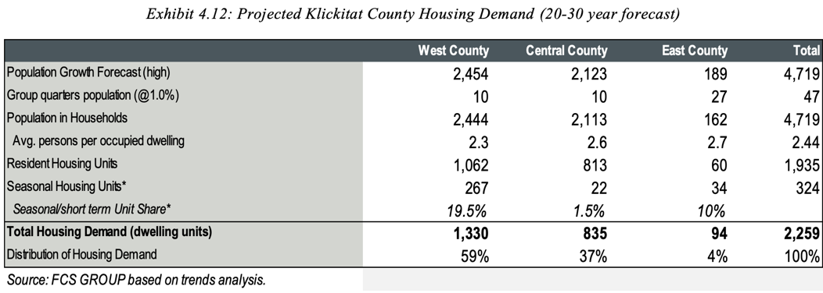
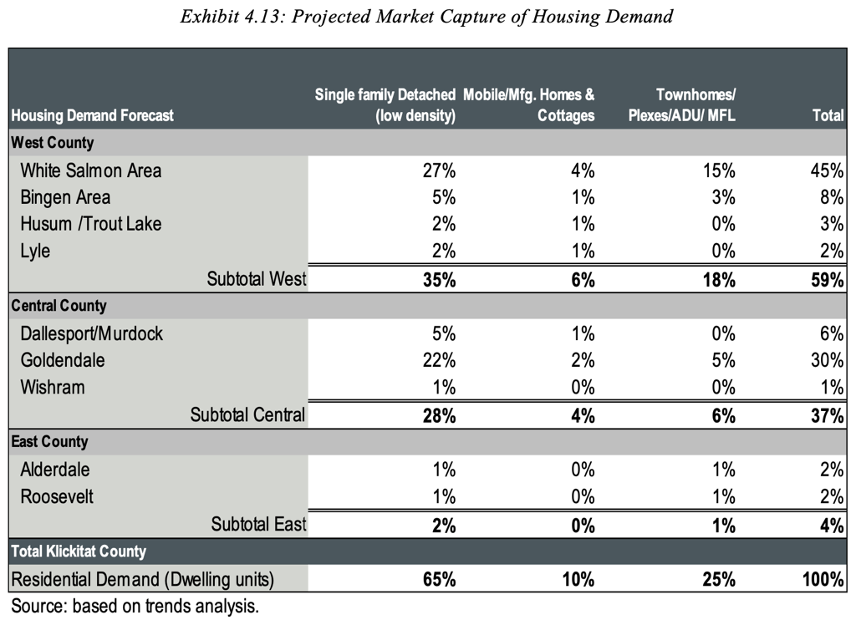
Buildable Lands and Demand
2020 Urbanization Study by FCS Group
NOTE: County population 23,461
WS population 2,727 (11.6%)

Slide 11
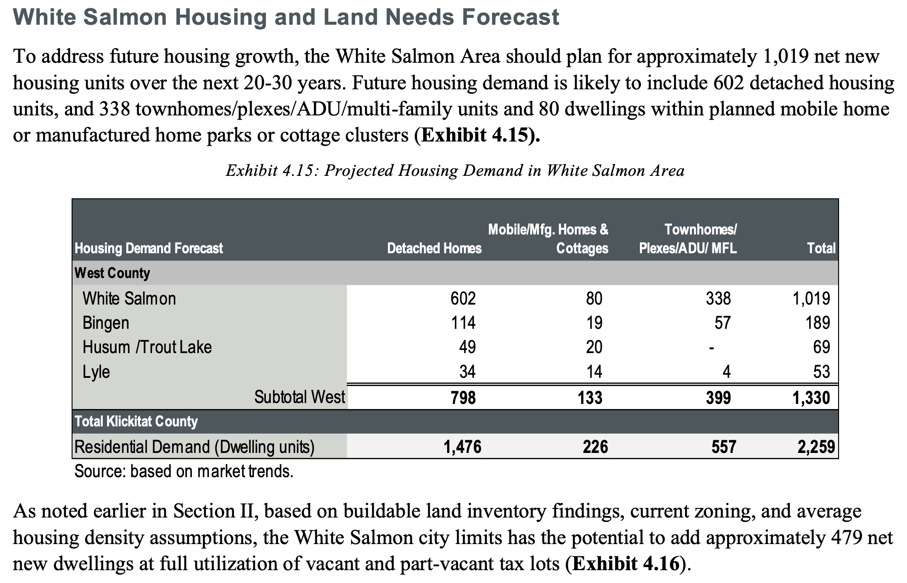
Buildable Lands and Demand

Slide 12
Growth Trends
277 homes on an average of 50’ x 100’ lots (approx. 5 units/acre gross) would require about 55 acres of net buildable land. At a higher density, the requirement would be lower. At say 10 units/acre gross, it would be about 27 acres.
479 homes on an average of 50’ x 100’ lots (approx. 4 units/acre gross) would require about 95 acres of net buildable land. At a higher density, the requirement would be lower. At say 10 units/acre gross, it would be about 47 acres.

Slide 13
Buildable Lands and Demand
NOTE: County population 23,461
WS population 2,727 (11.6%)

Slide 14
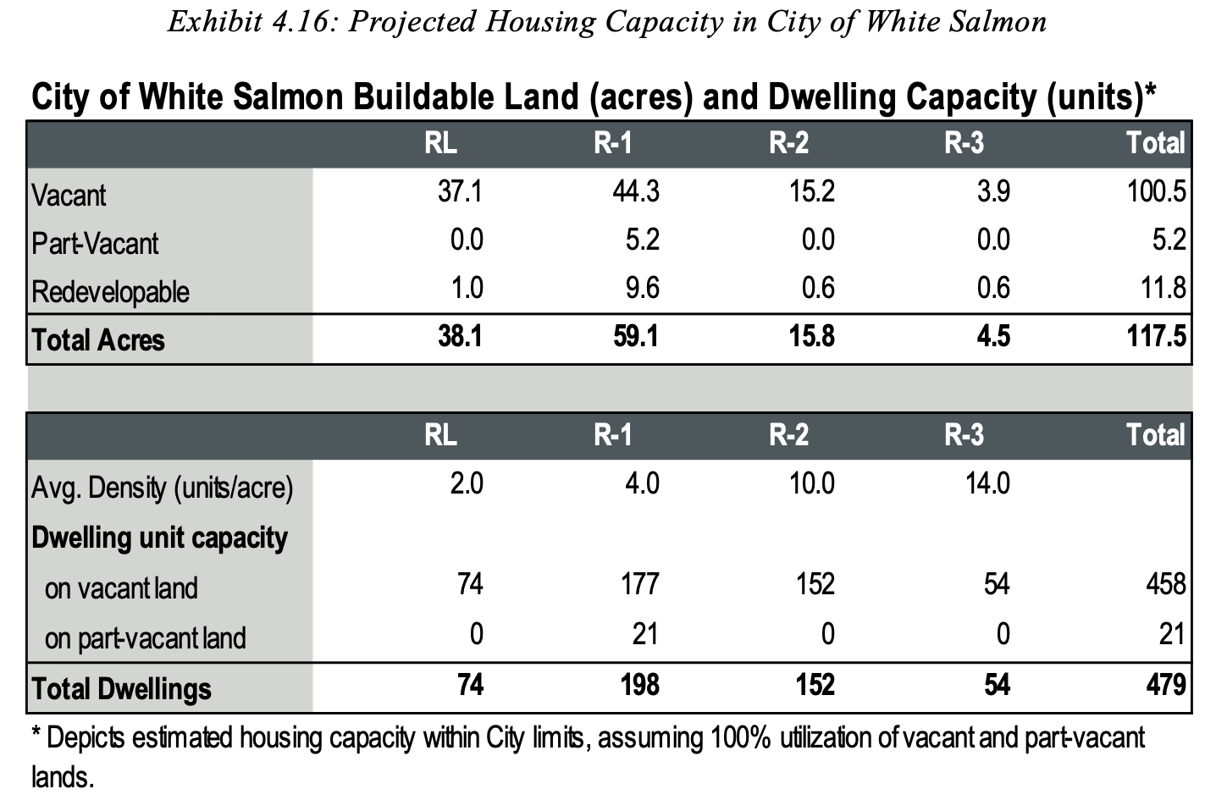
Buildable Lands and Demand
Gross Density
= 4.07
NOTE: County population 23,461
WS population 2,727 (11.6%)

Slide 15
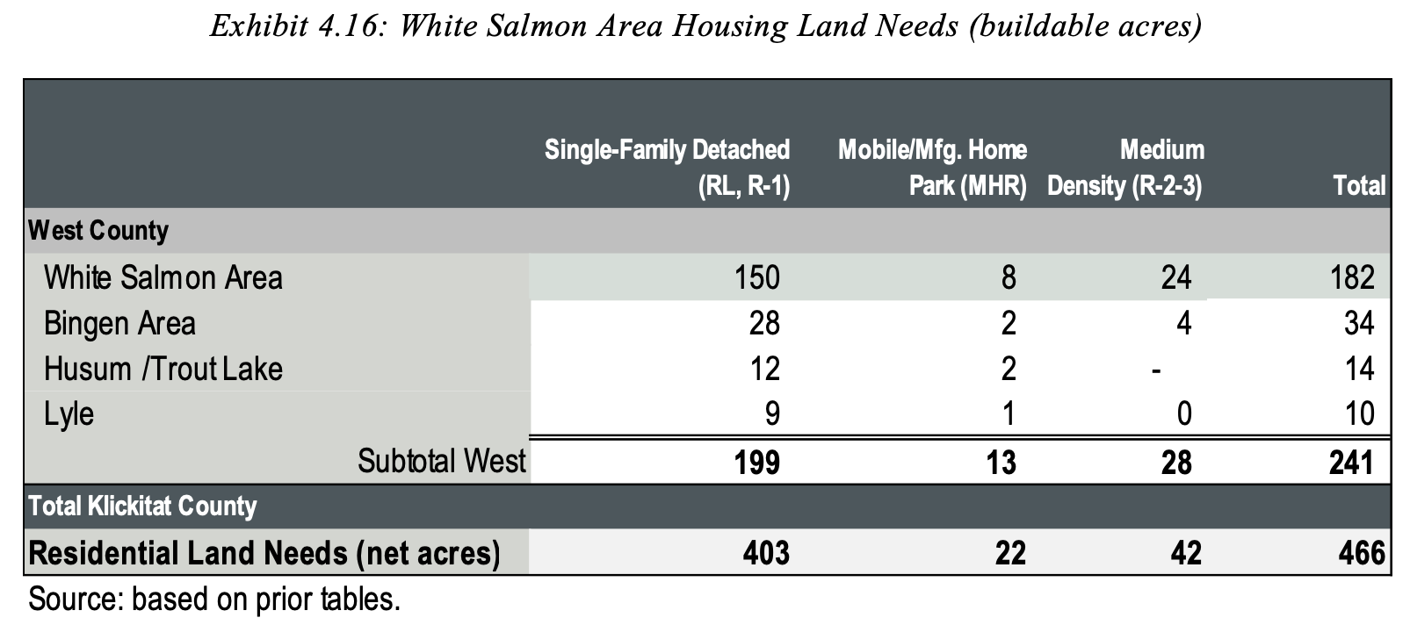
Buildable Lands and Demand
82.4%
4.3%
13.2%
NOTE: County population 23,461
WS population 2,727 (11.6%)

Slide 16
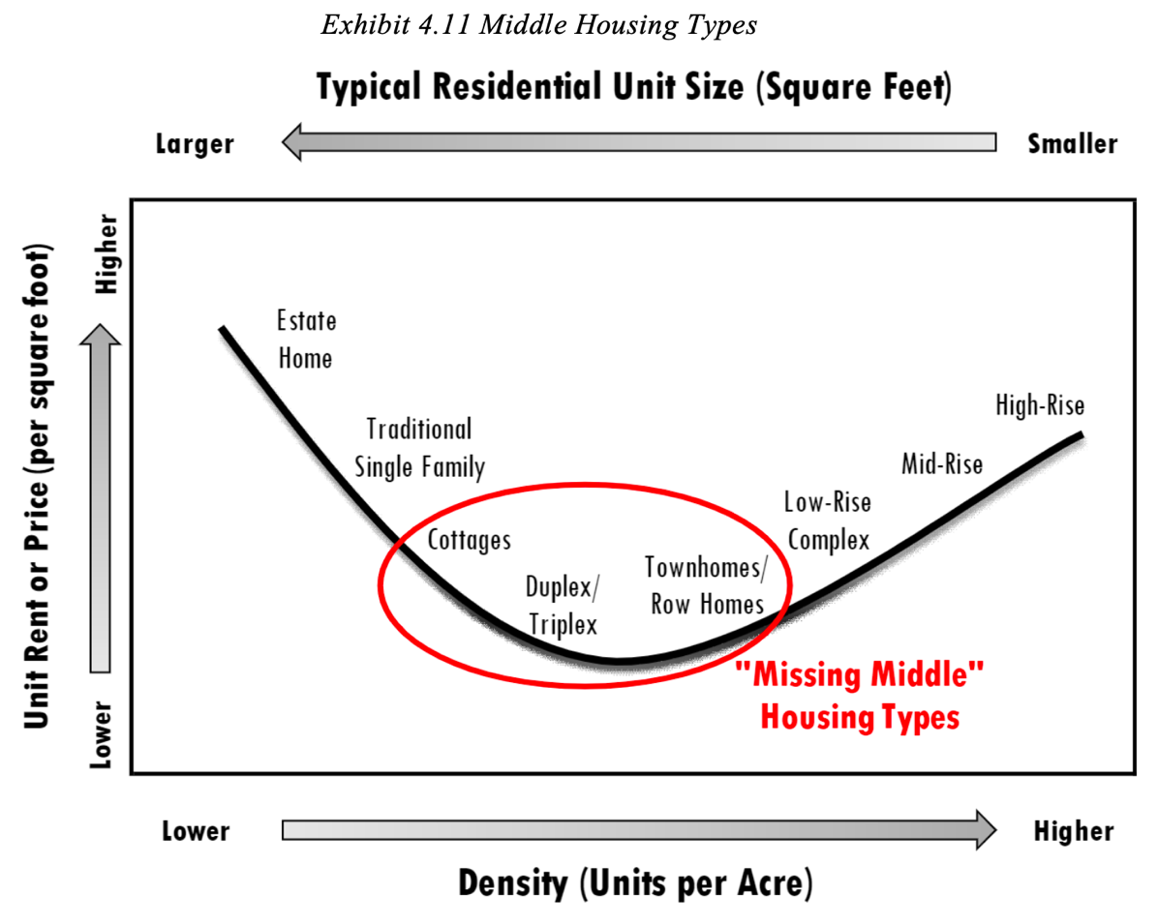
Re-balance to include “Missing Middle”?
NOTE: County population 23,461
WS population 2,727 (11.6%)

Slide 17
Re-balance to include “Missing Middle”?
NOTE: County population 23,461
WS population 2,727 (11.6%)

Slide 18
Conclusions
A ”straight line” projection of population growth does not suggest additional land needs to be annexed for IN-CITY growth, particularly with more compact models.
A bigger problem is getting the development needed to occur EVEN ON EXISTING INVENTORY.
The City should determine how much it wants to incentivize OUT OF CITY growth (which will likely be expensive SFDs on large properties)
Re-balancing in favor of “missing middle” and more compact SFDs can greatly increase the capacity of land to accommodate growth, and to provide less expensive home types

Slide 19
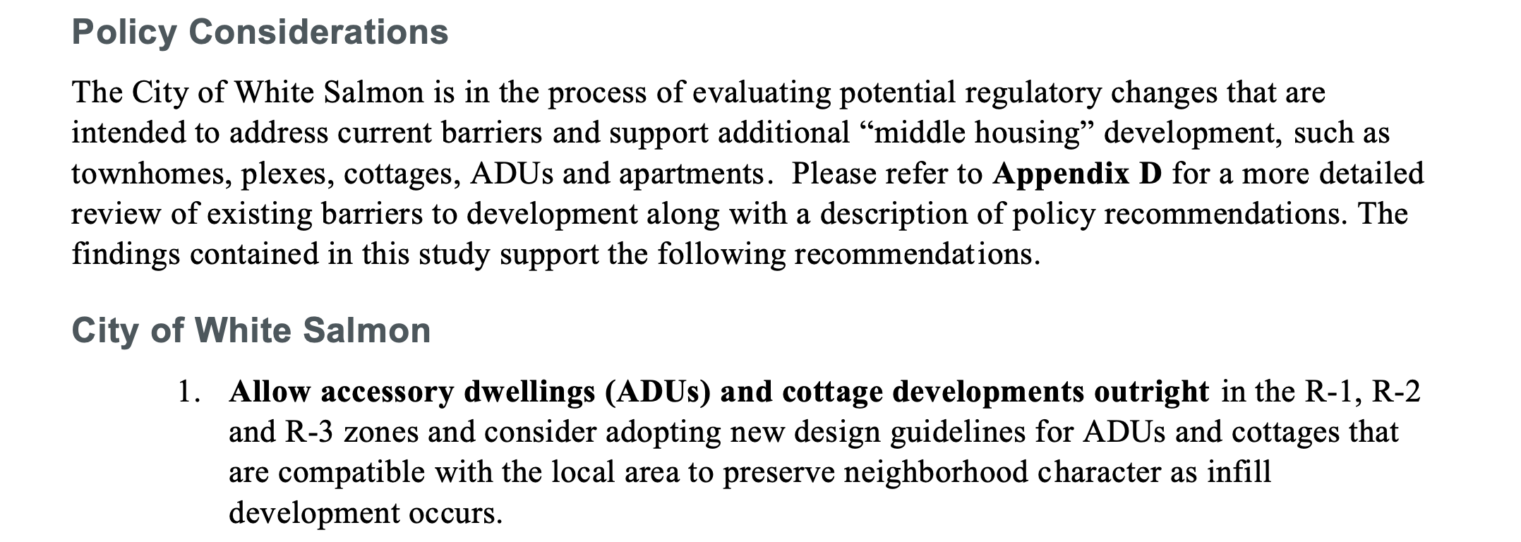
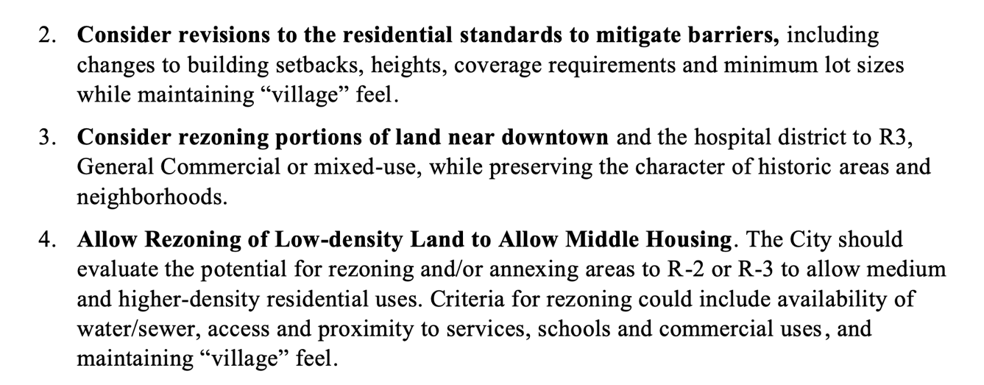
Other Recommendations in Urbanization Report

Slide 20
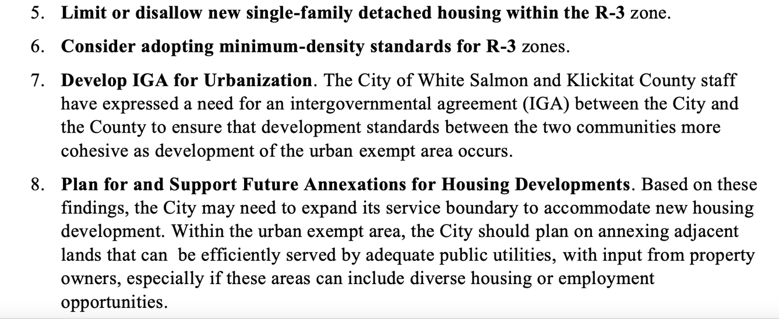
Other Recommendations in Urbanization Report
?

Slide 21
Discussion and/or Questions!

Slide 22
Outreach Results (Tentative)

Slide 23
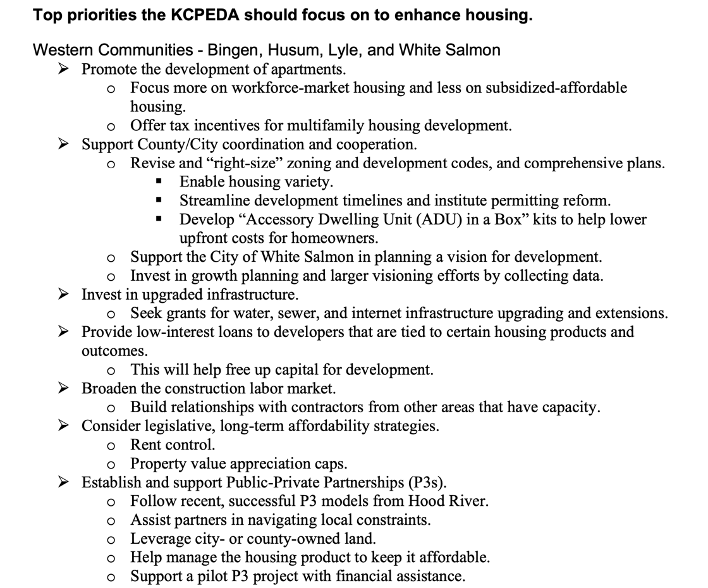
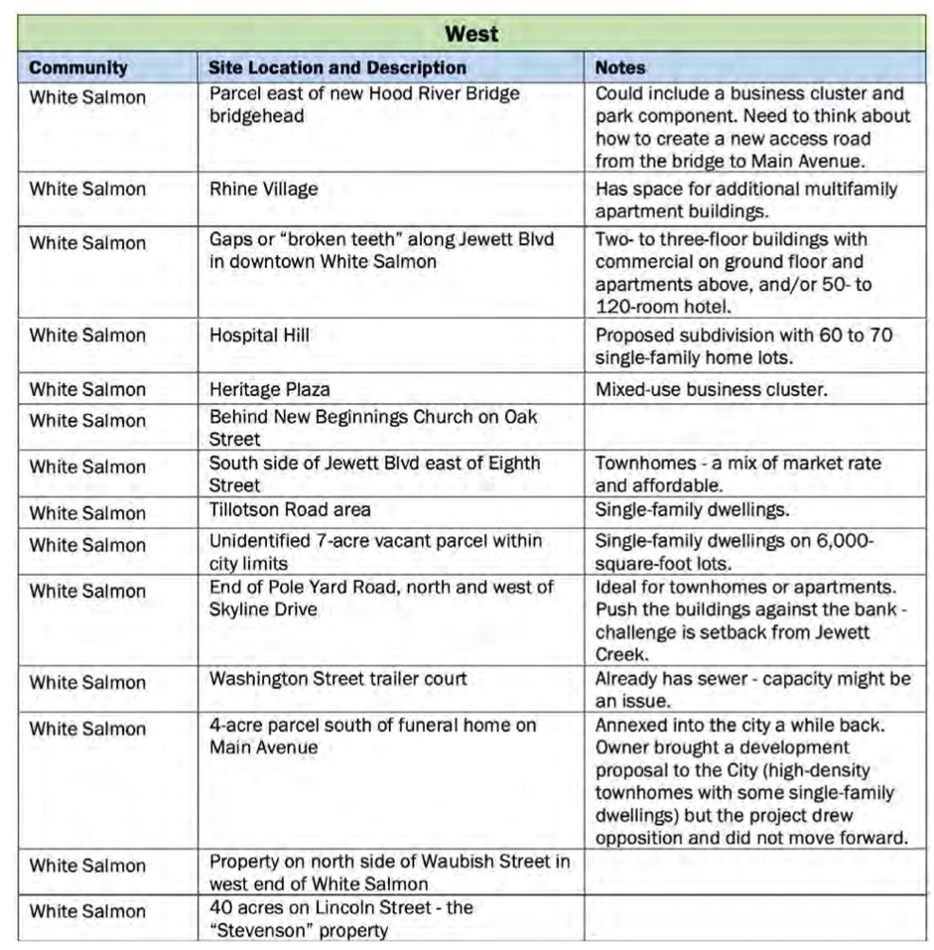
Outreach Results (Urbanization Study)

Slide 24
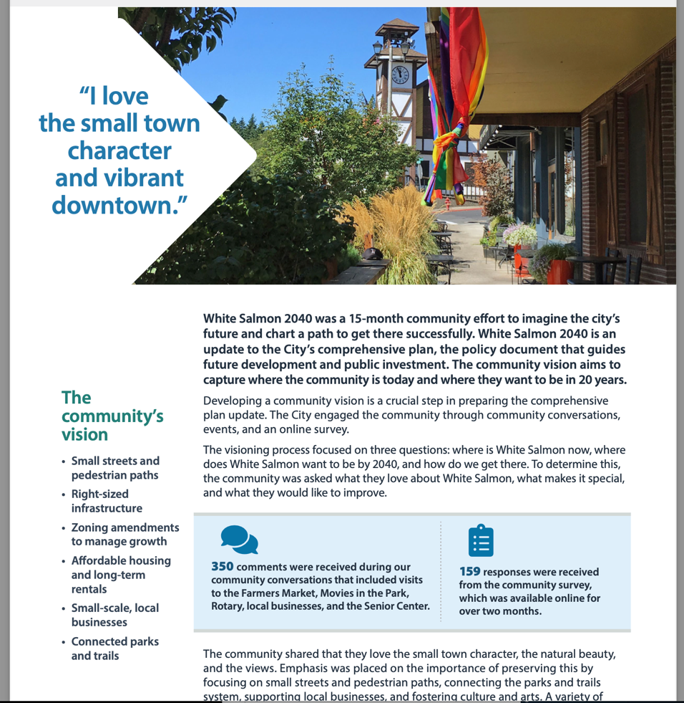
Outreach Results (Vision 2040)

Slide 25
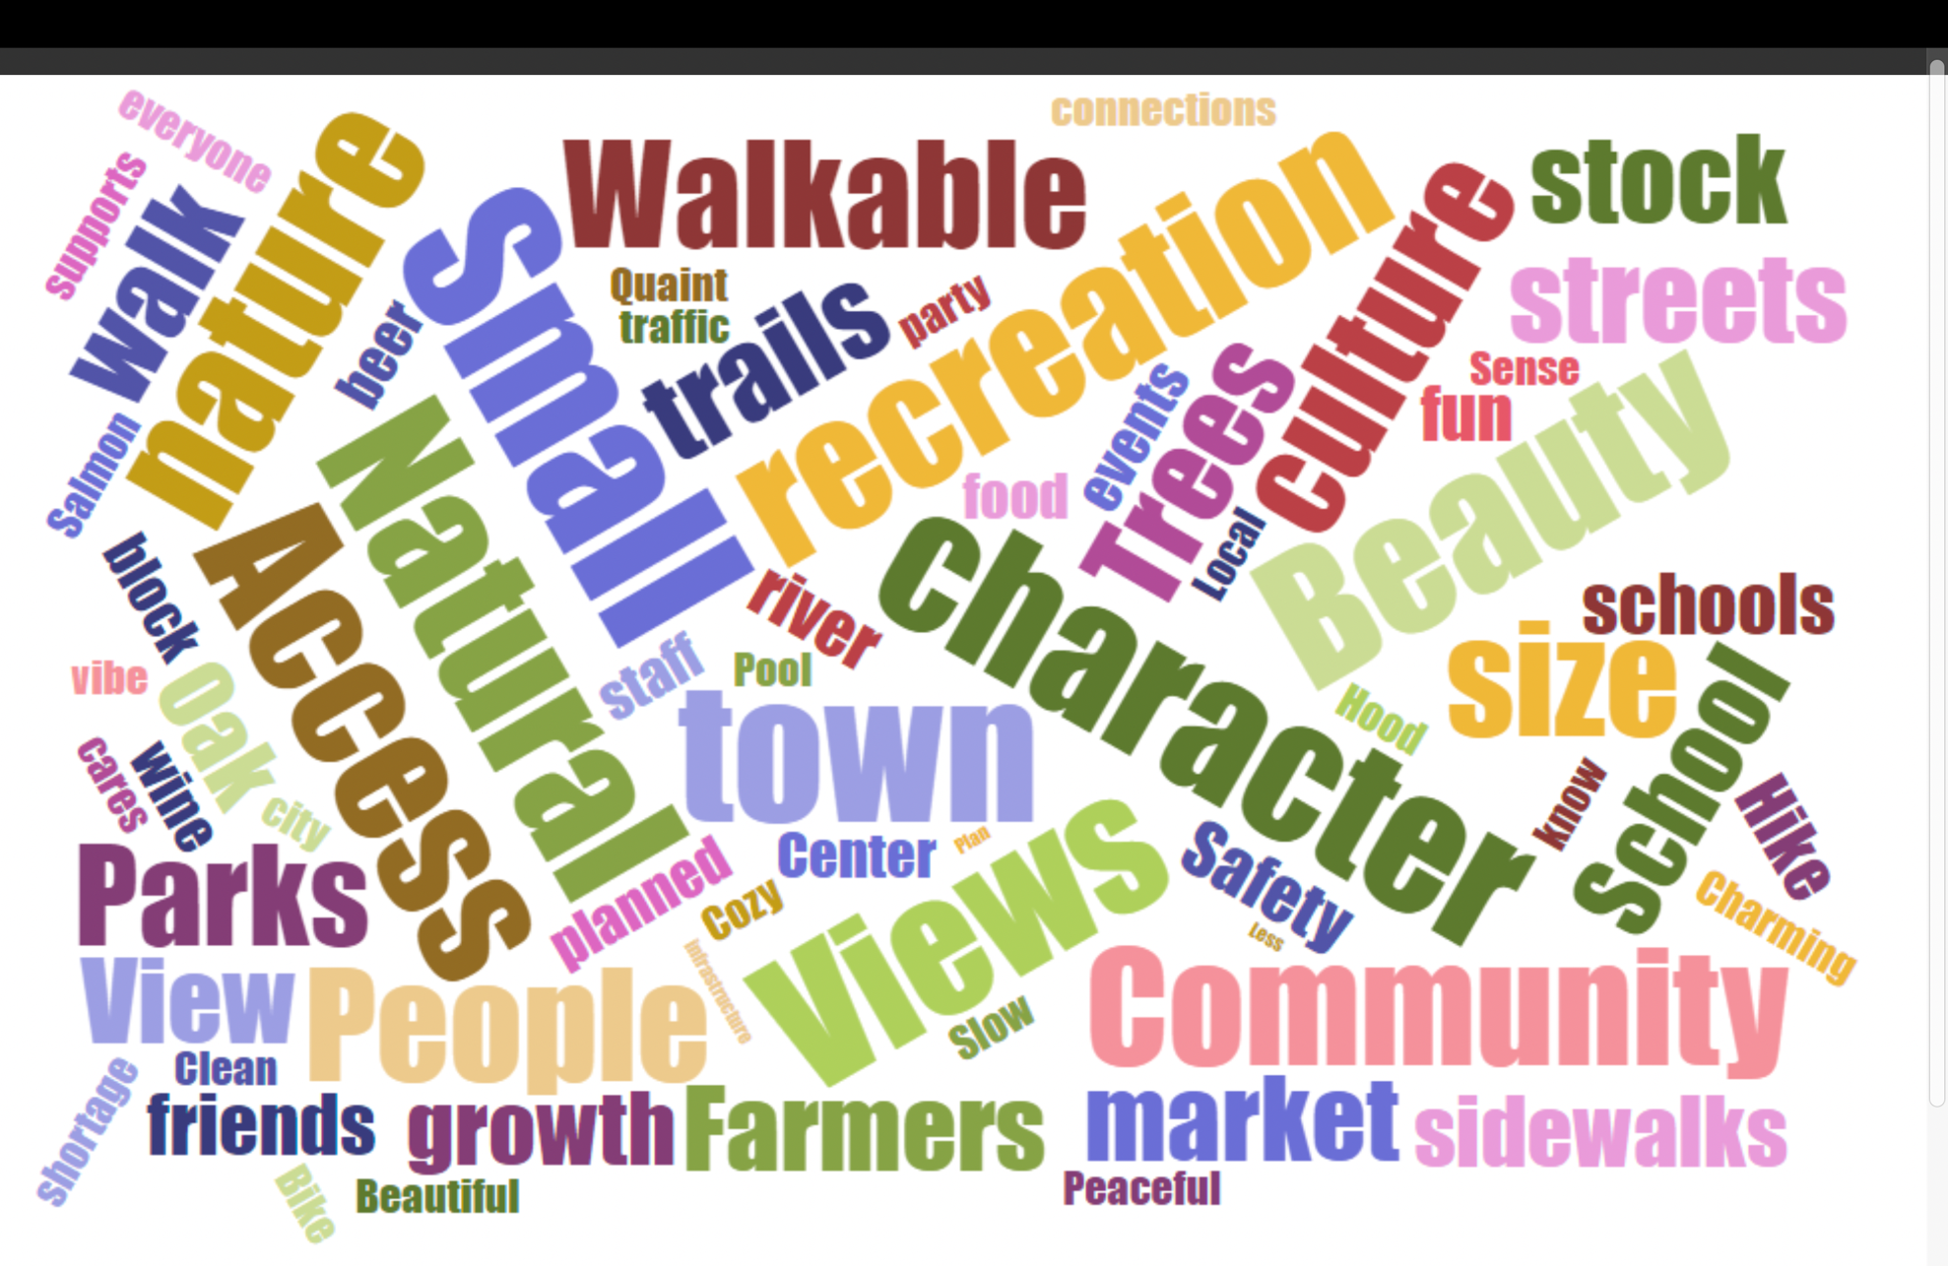

Slide 34
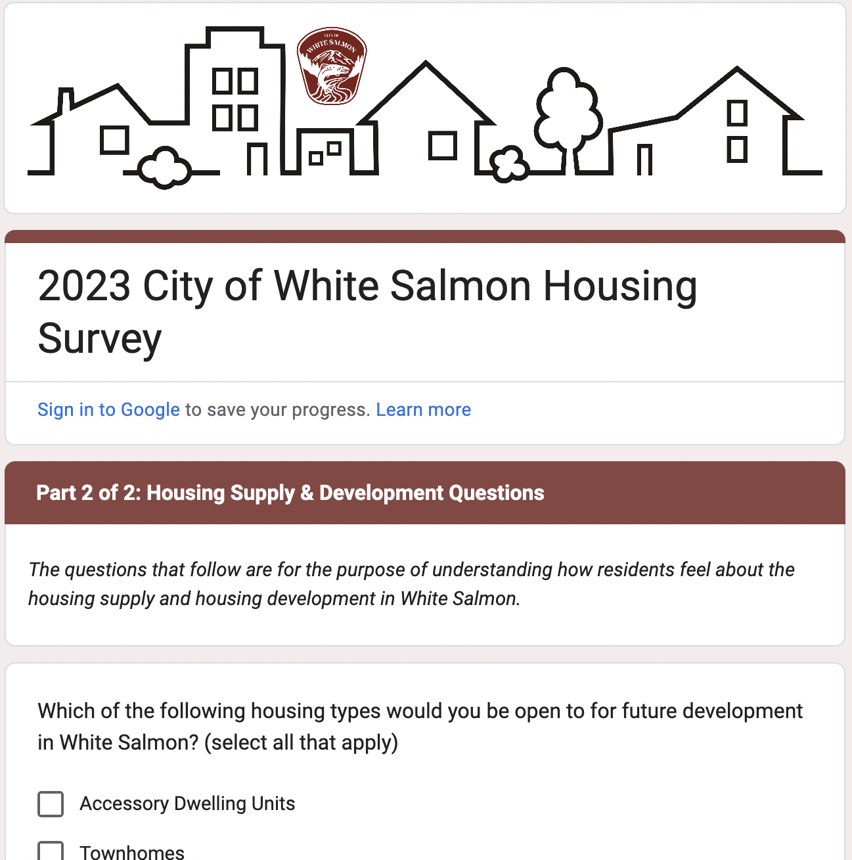
Current Survey - Highlights
173 responses to date
4 Spanish language responses
Multiple choice and open-ended
Closes tomorrow

Slide 35
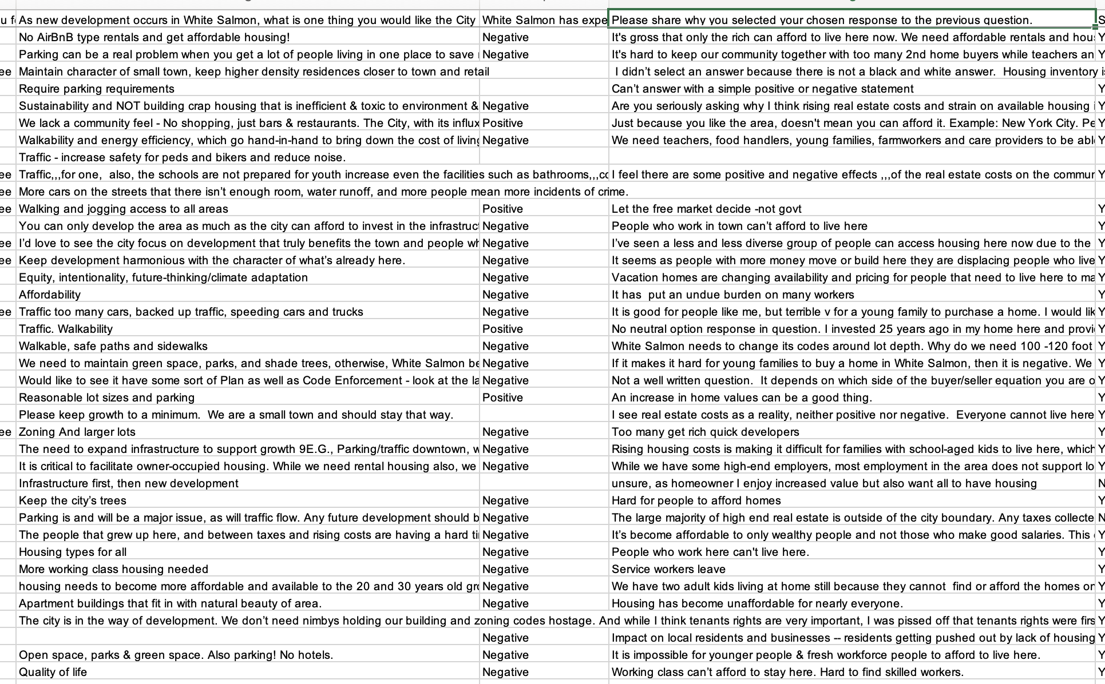

Slide 36
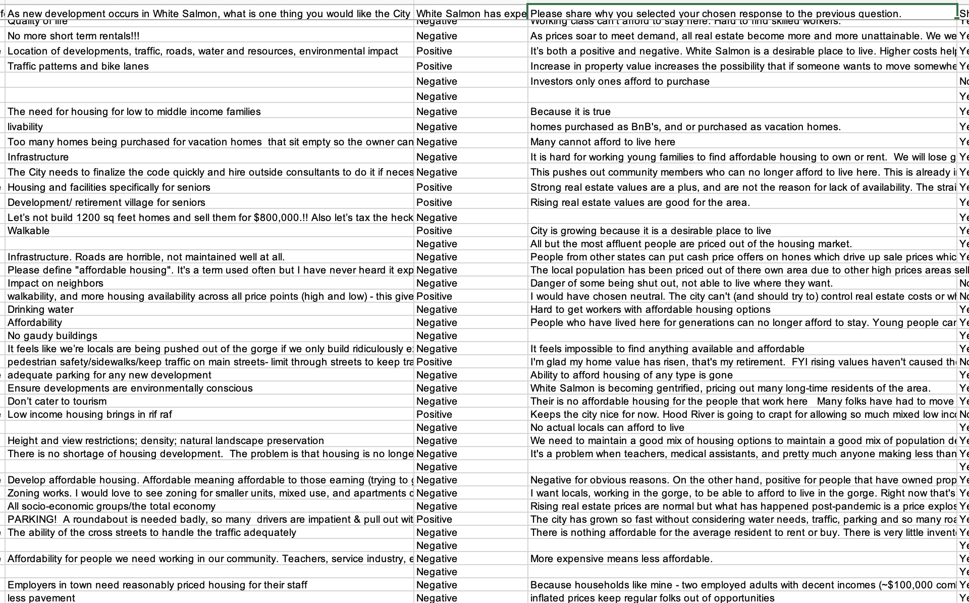

Slide 37
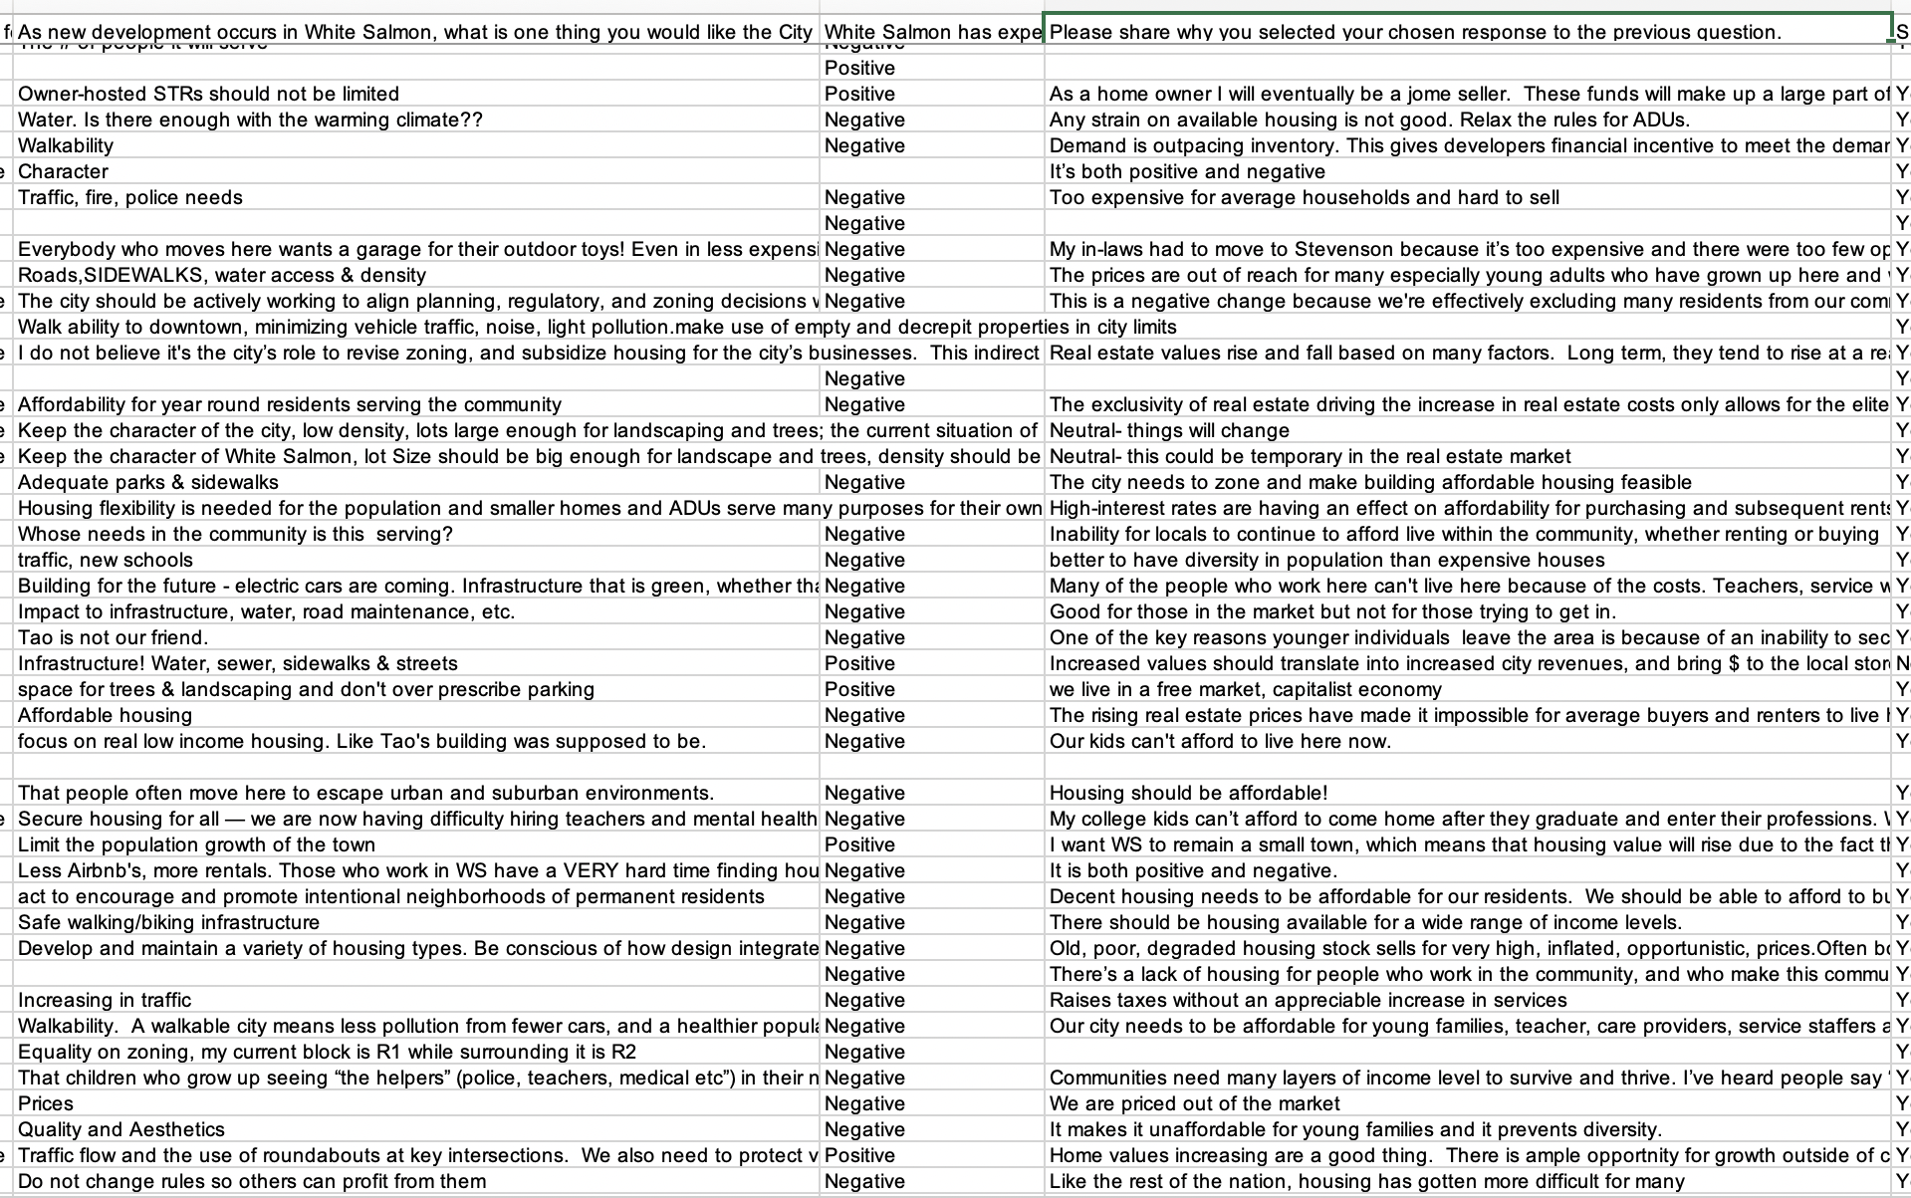

Slide 38
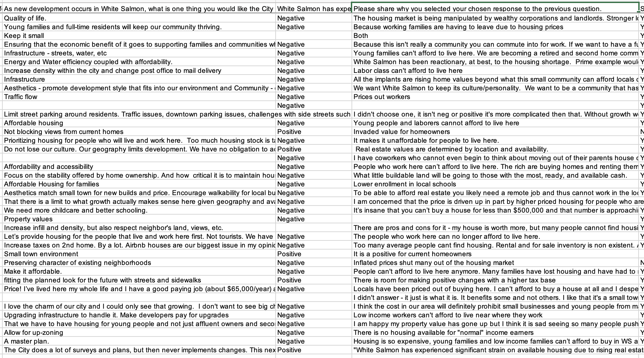

Slide 39
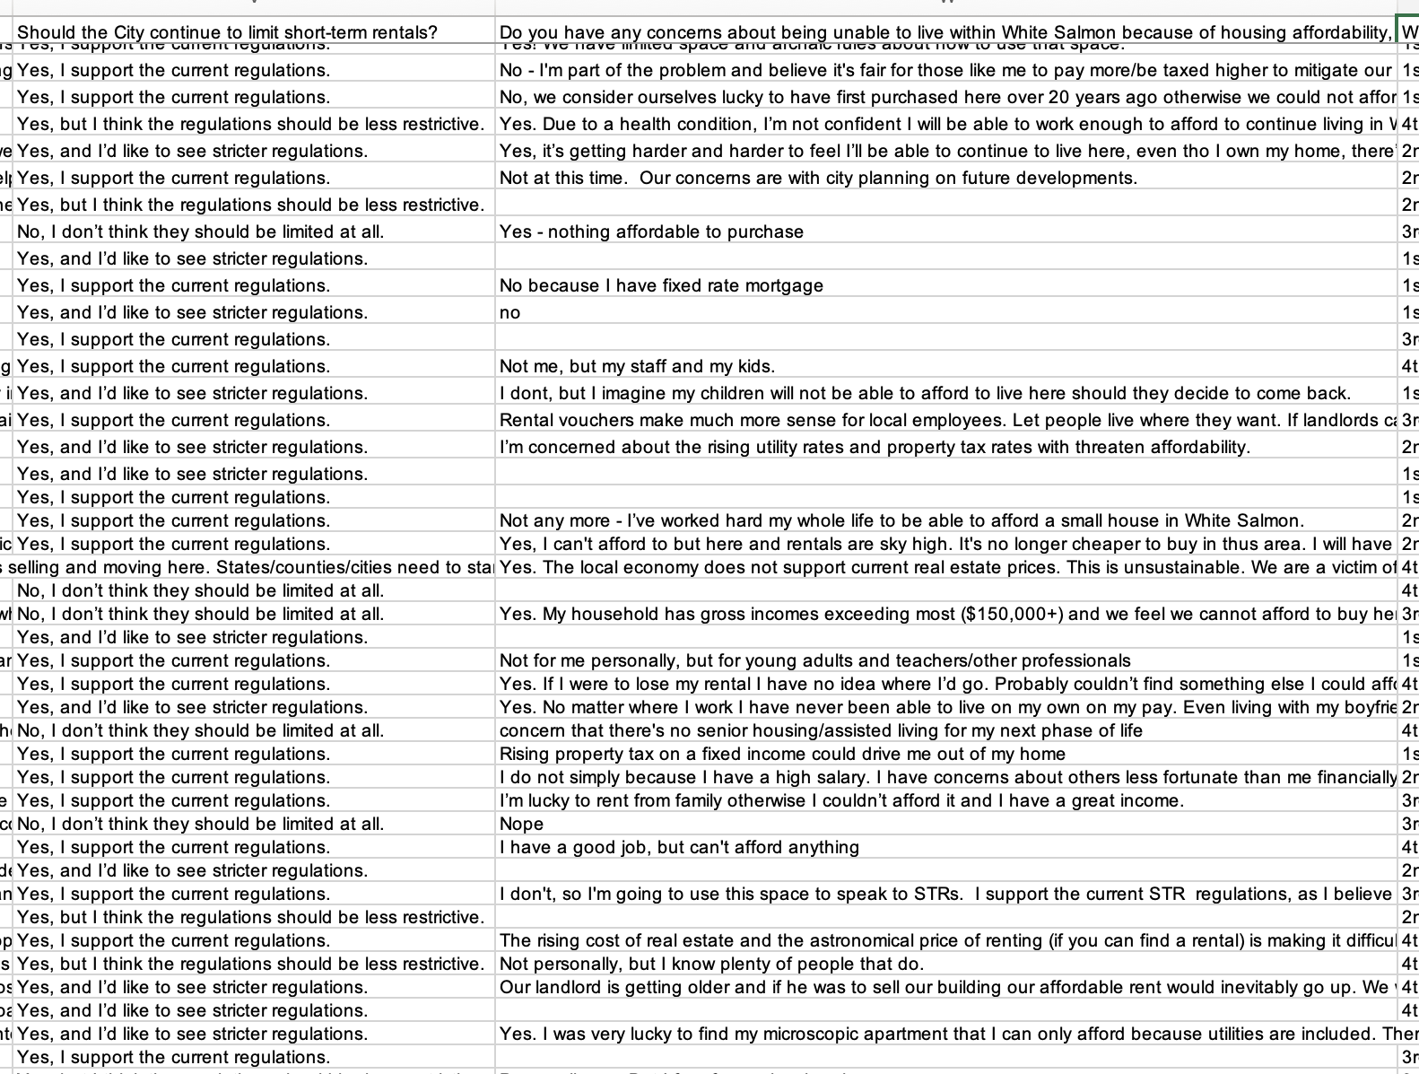

Slide 40
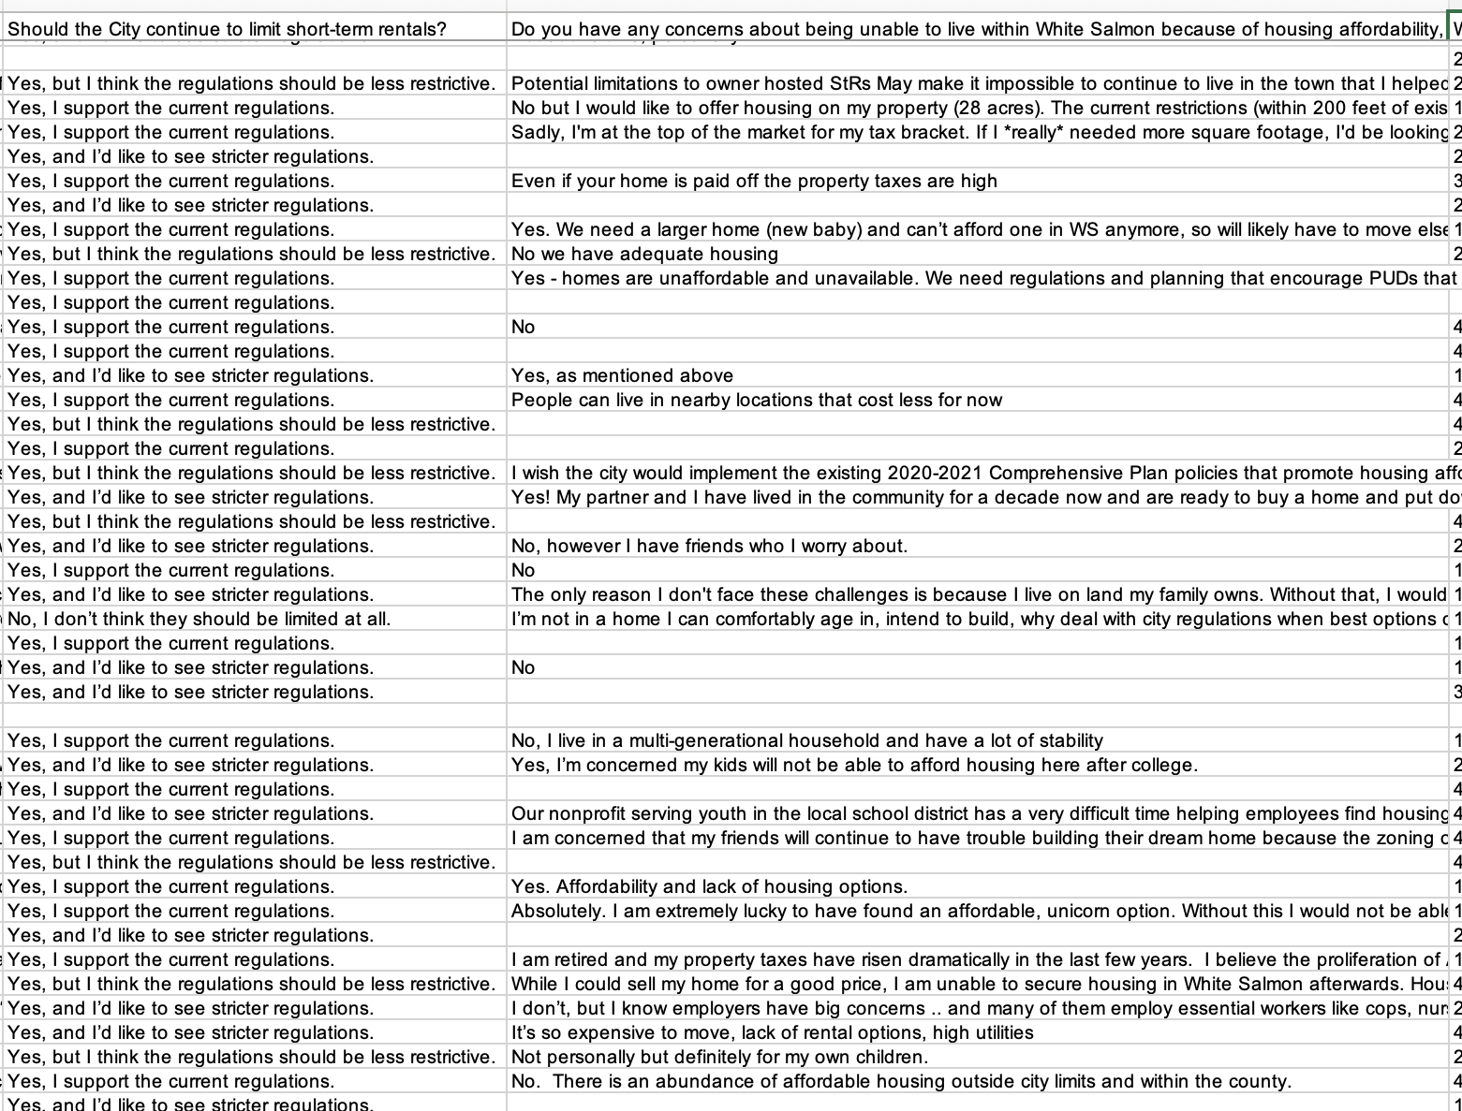

Slide 41
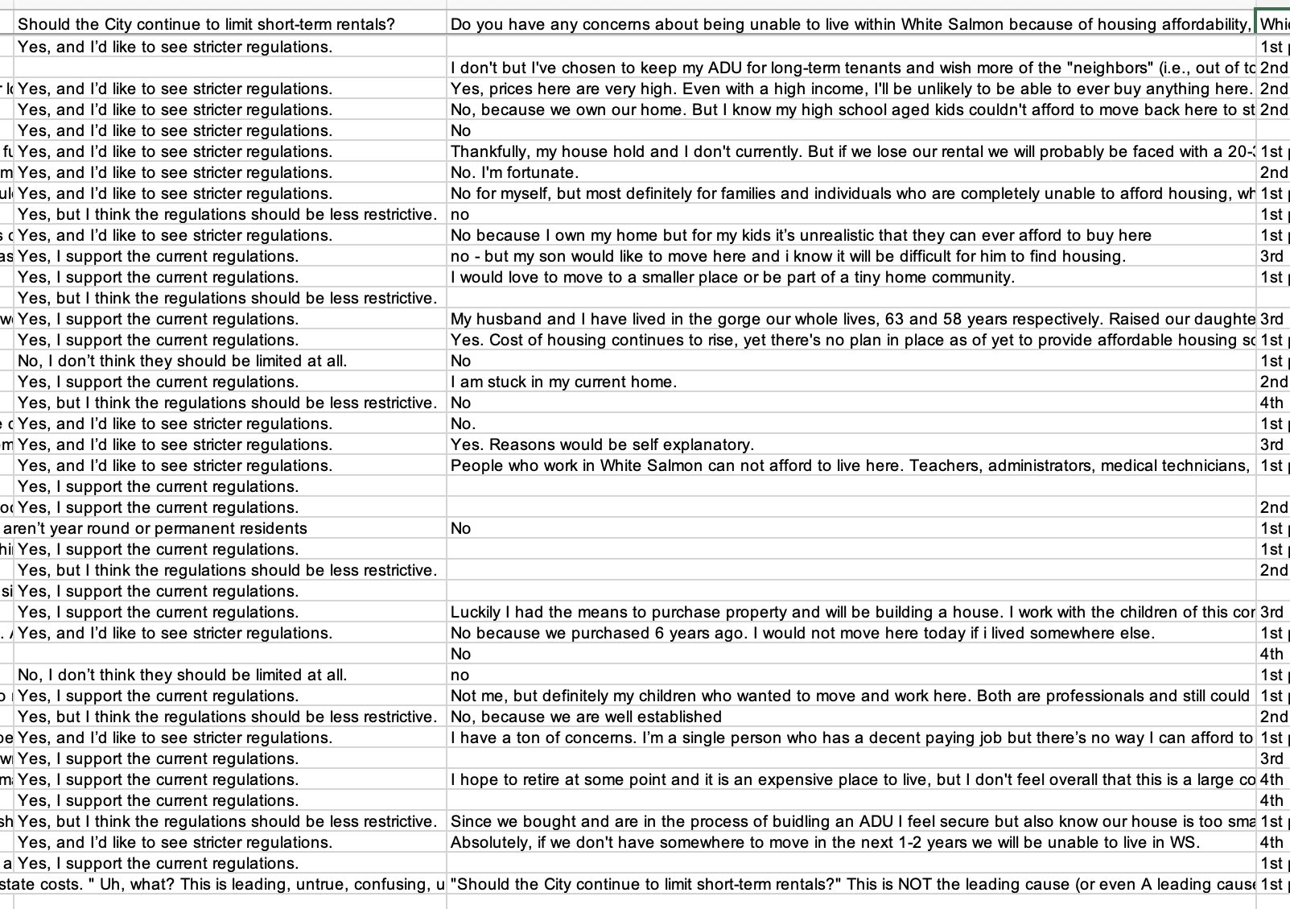

Slide 42
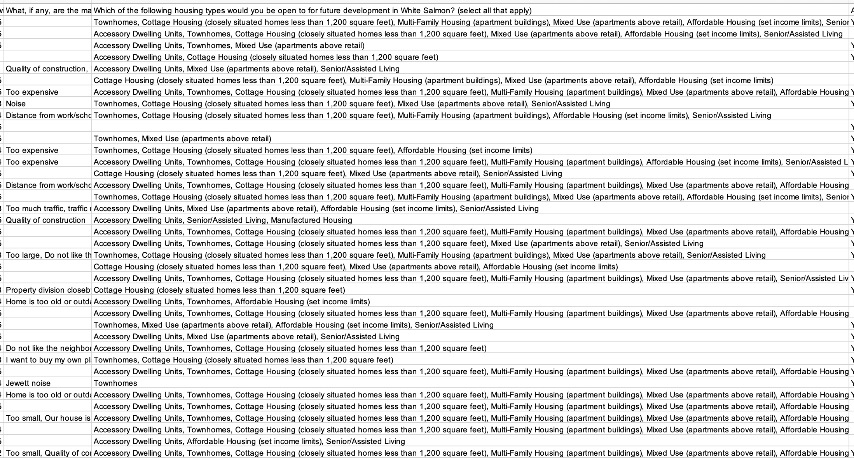

Slide 43
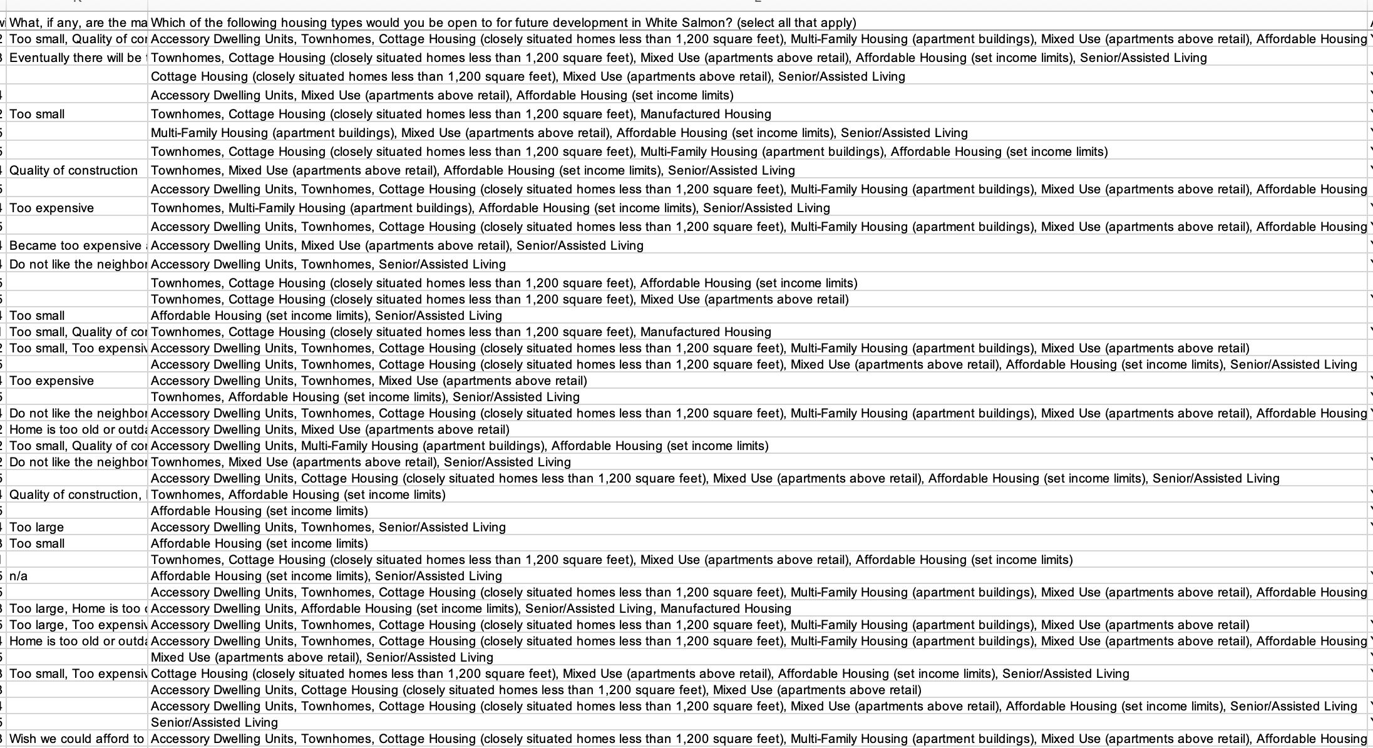

Slide 44
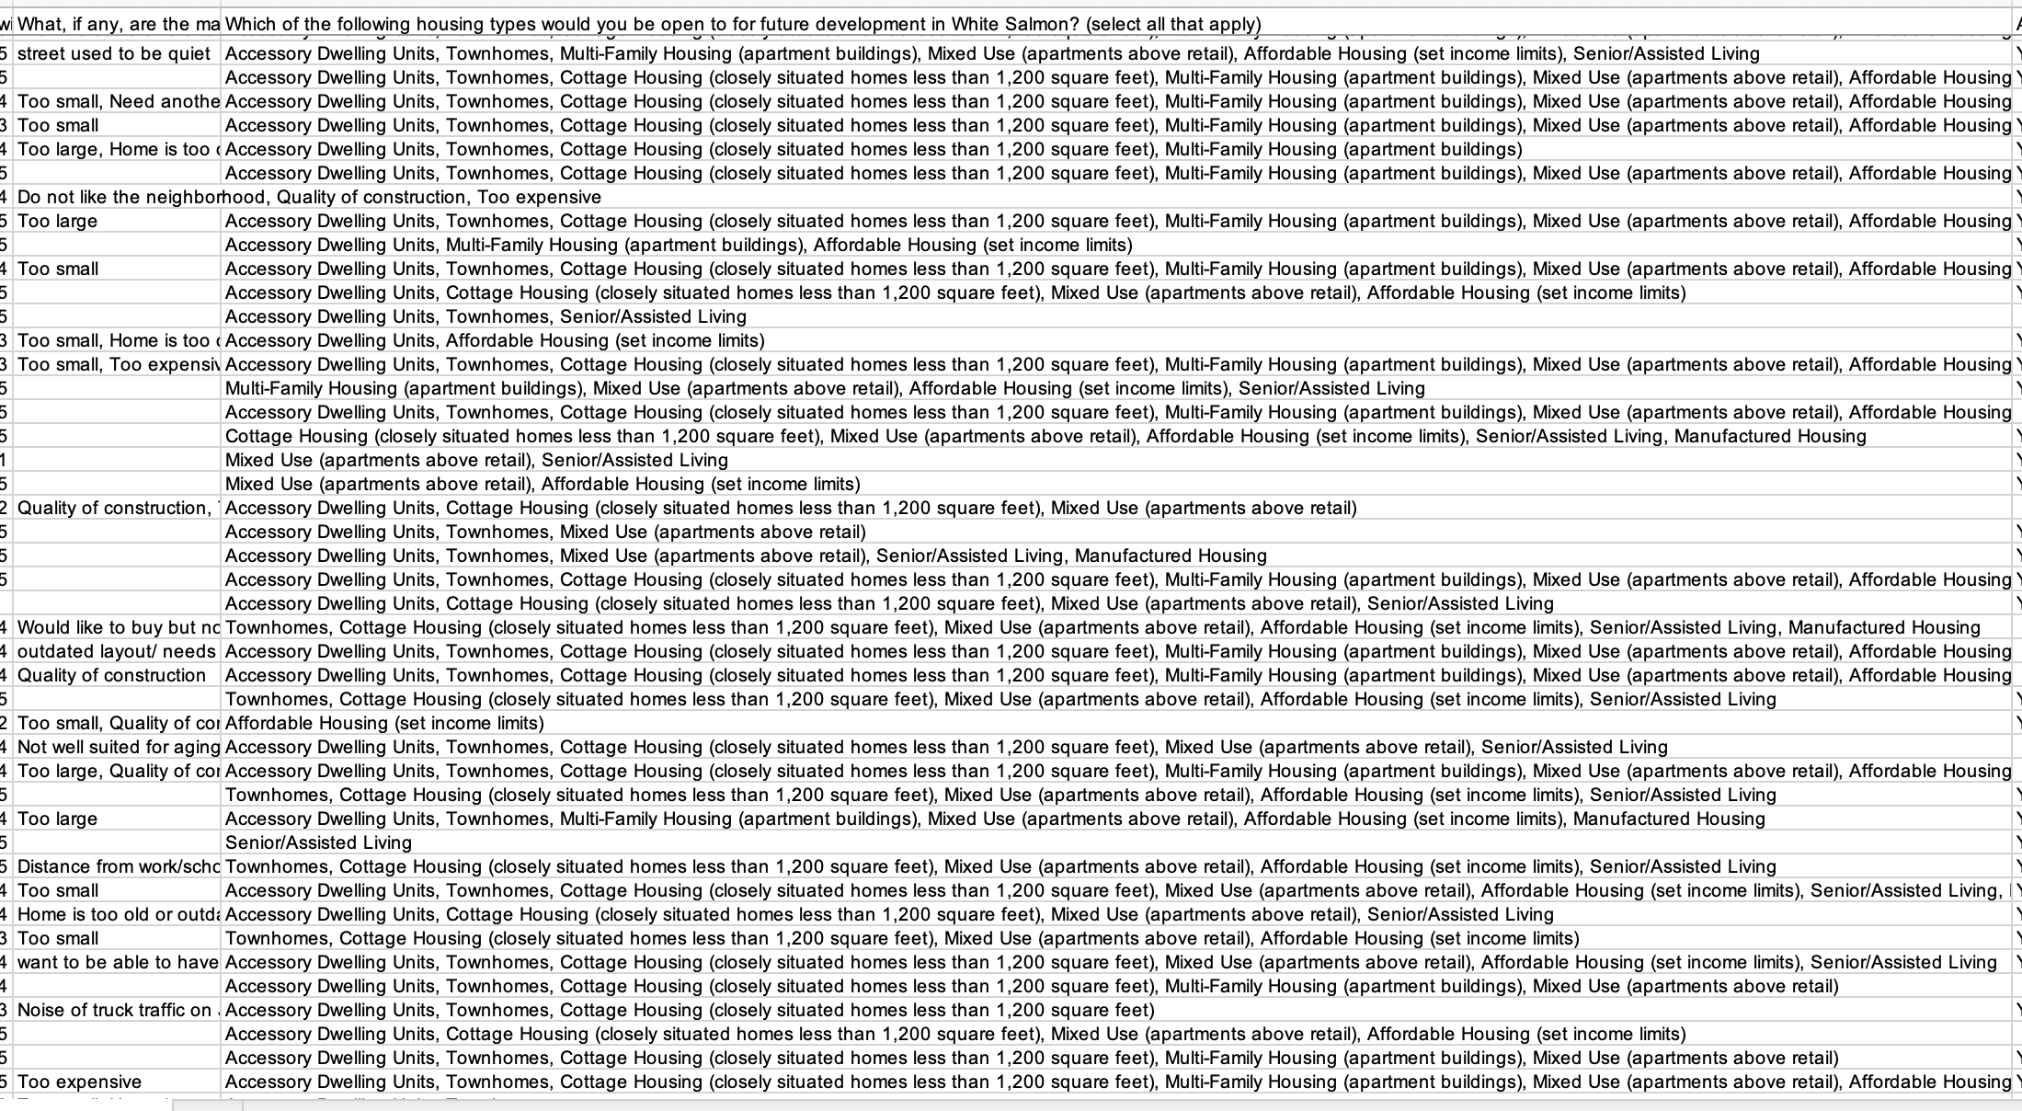

Slide 45
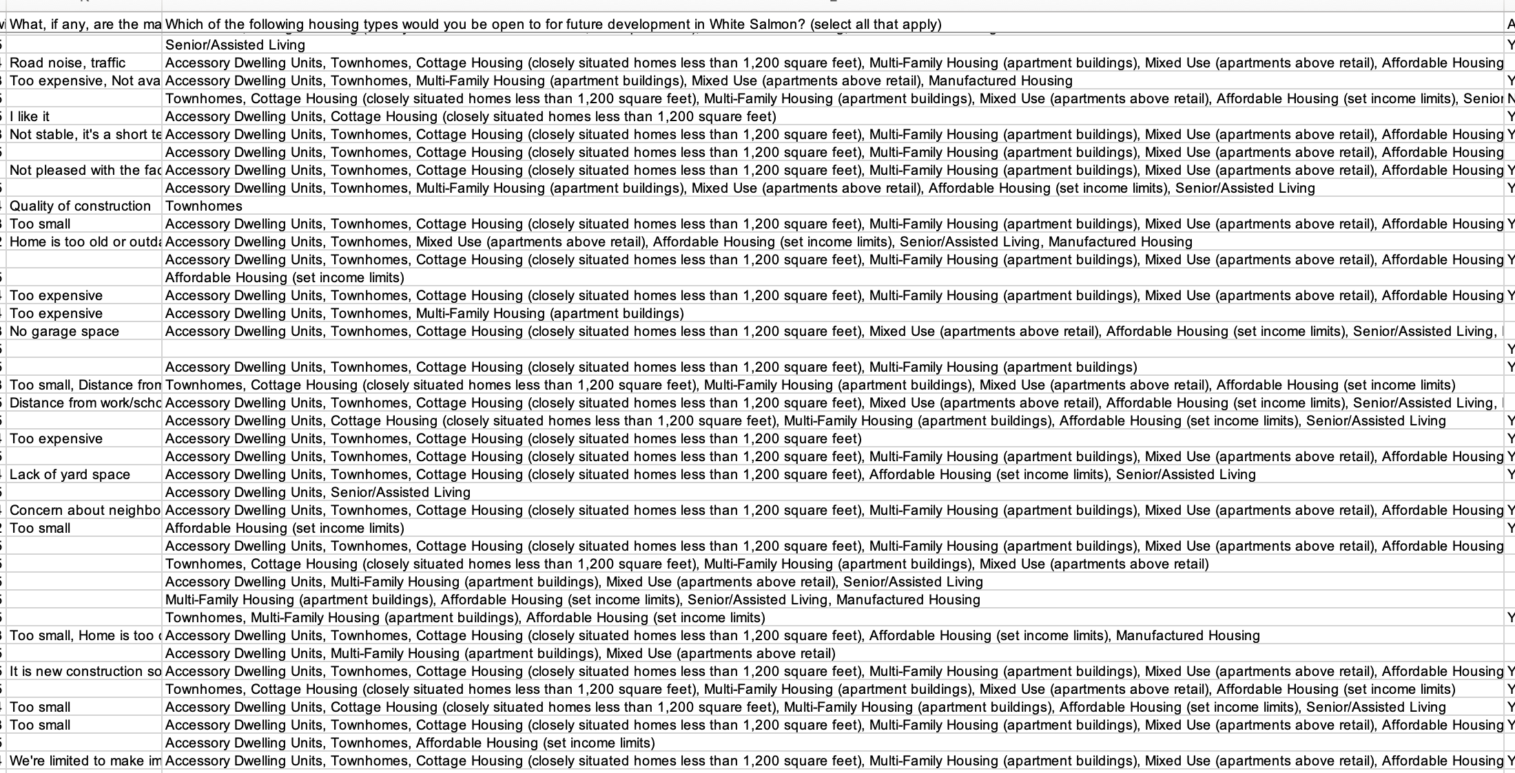

Slide 46
Discussion and/or Questions!

Slide 47
Housing Action Plan - Draft
A framework, not a final result…

Slide 48
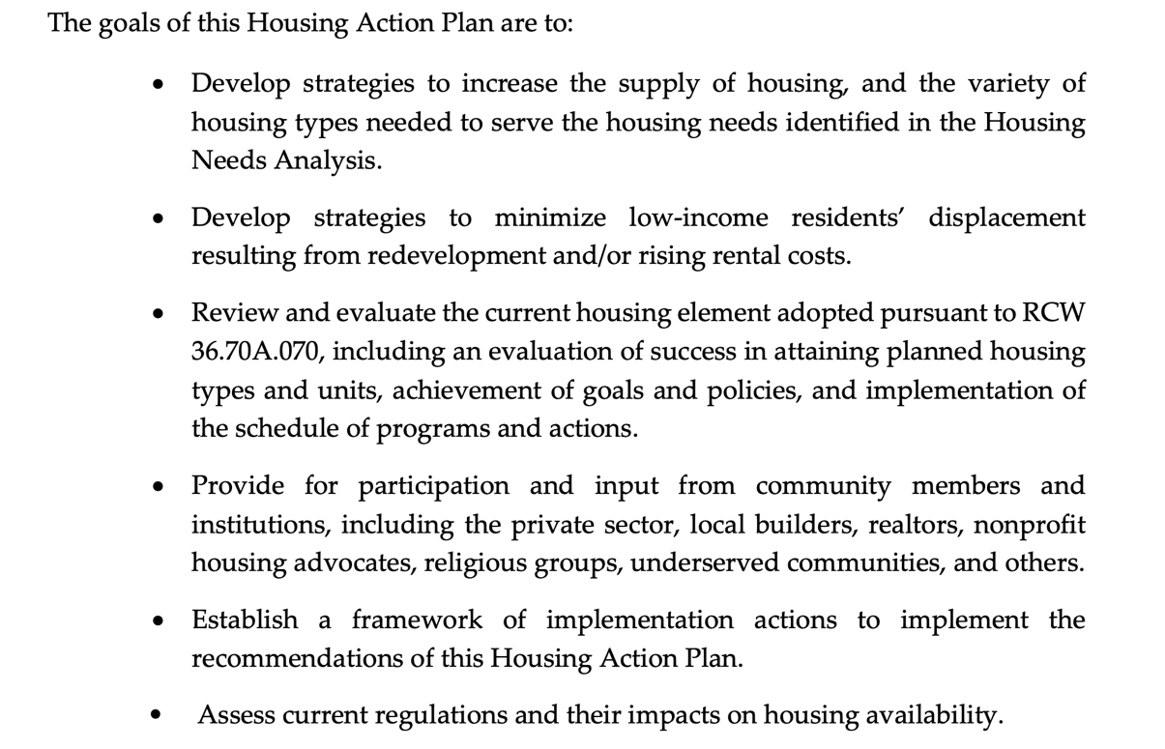

Slide 49
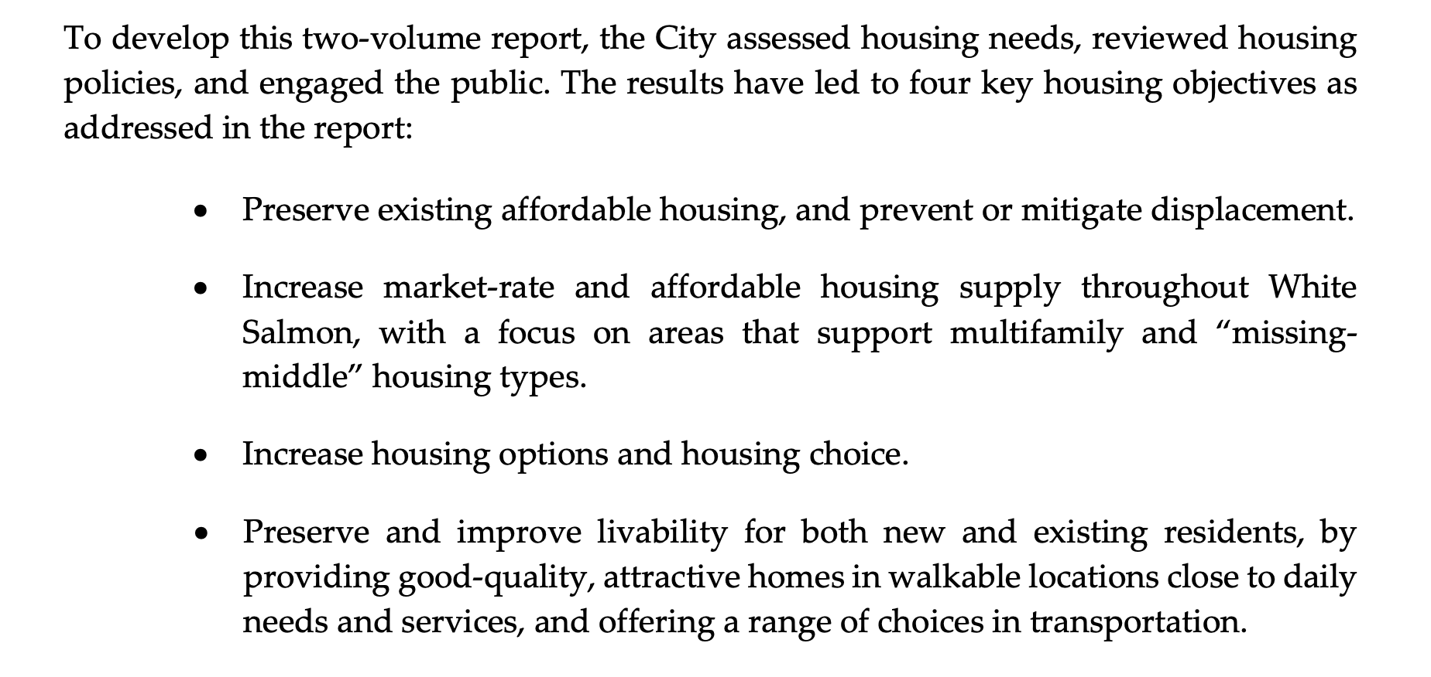

Slide 50
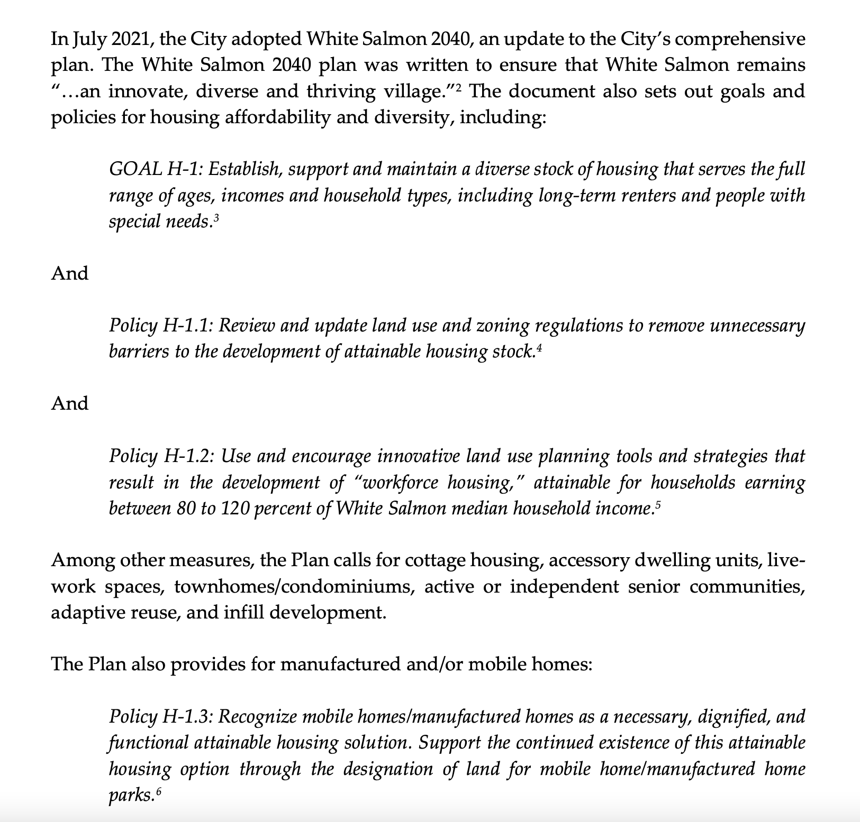

Slide 51
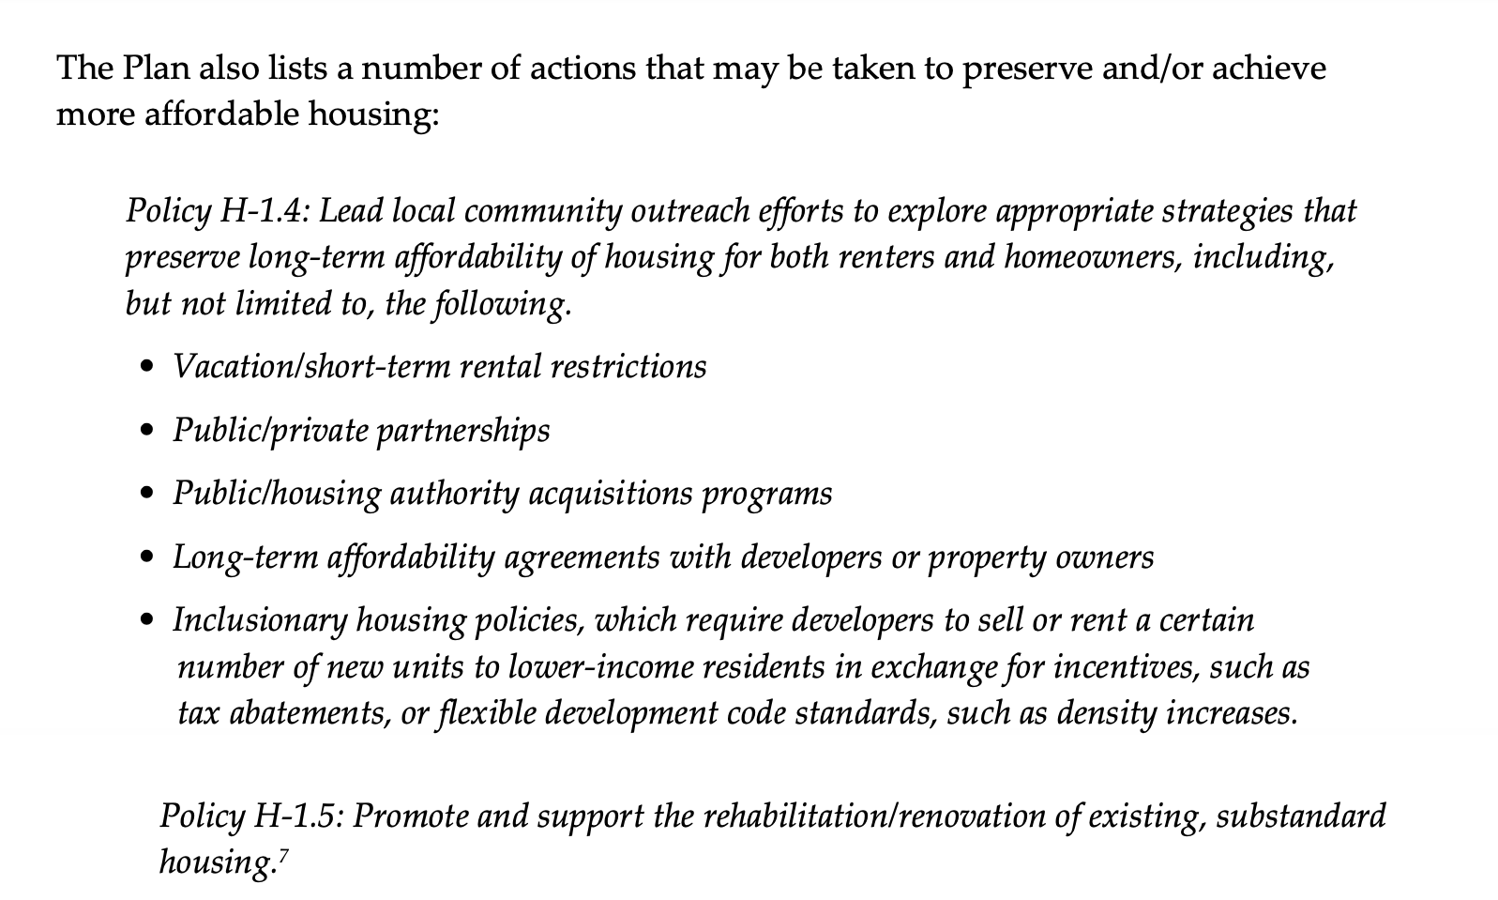

Slide 52
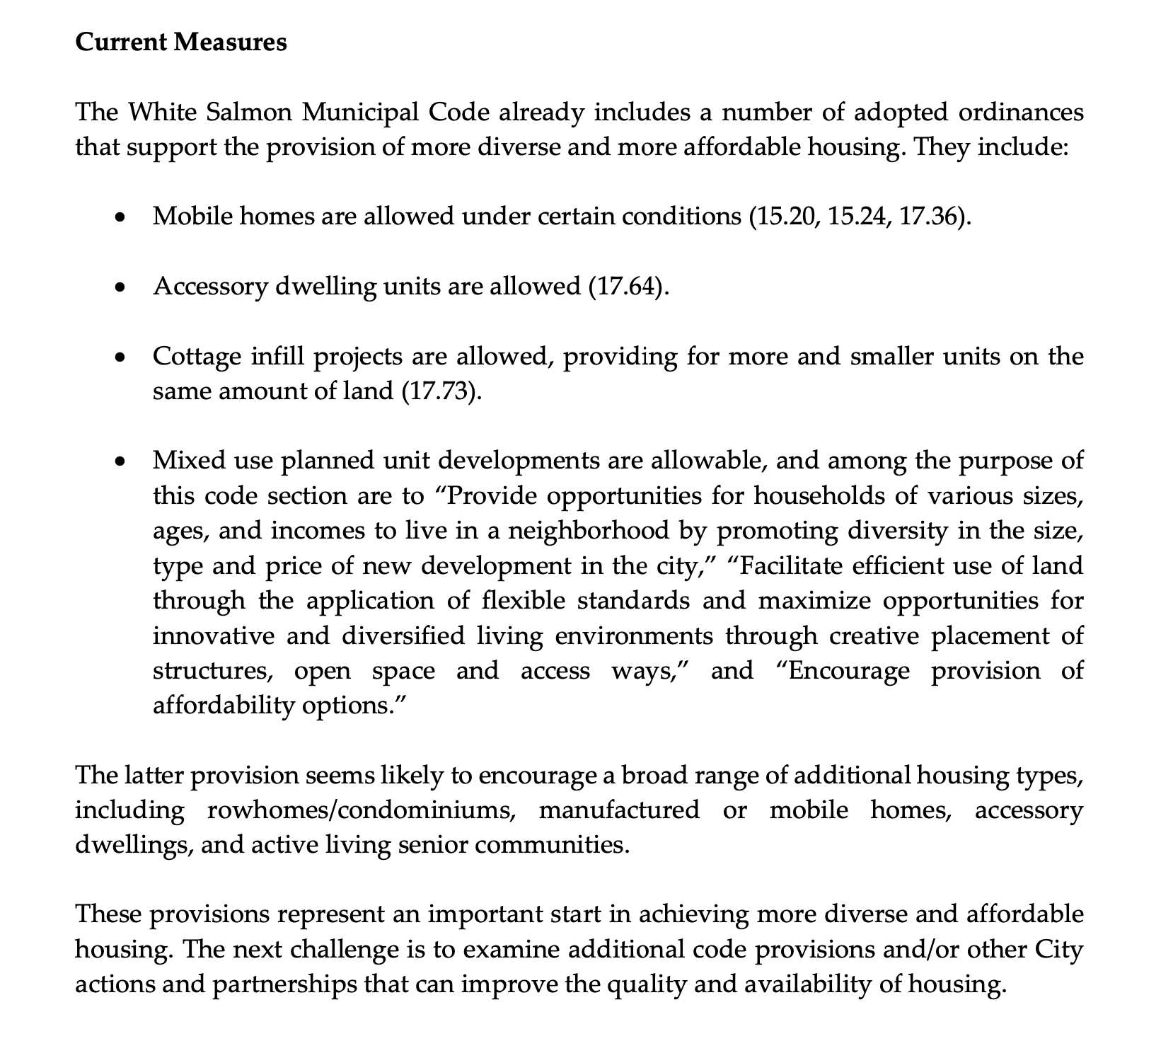

Slide 53
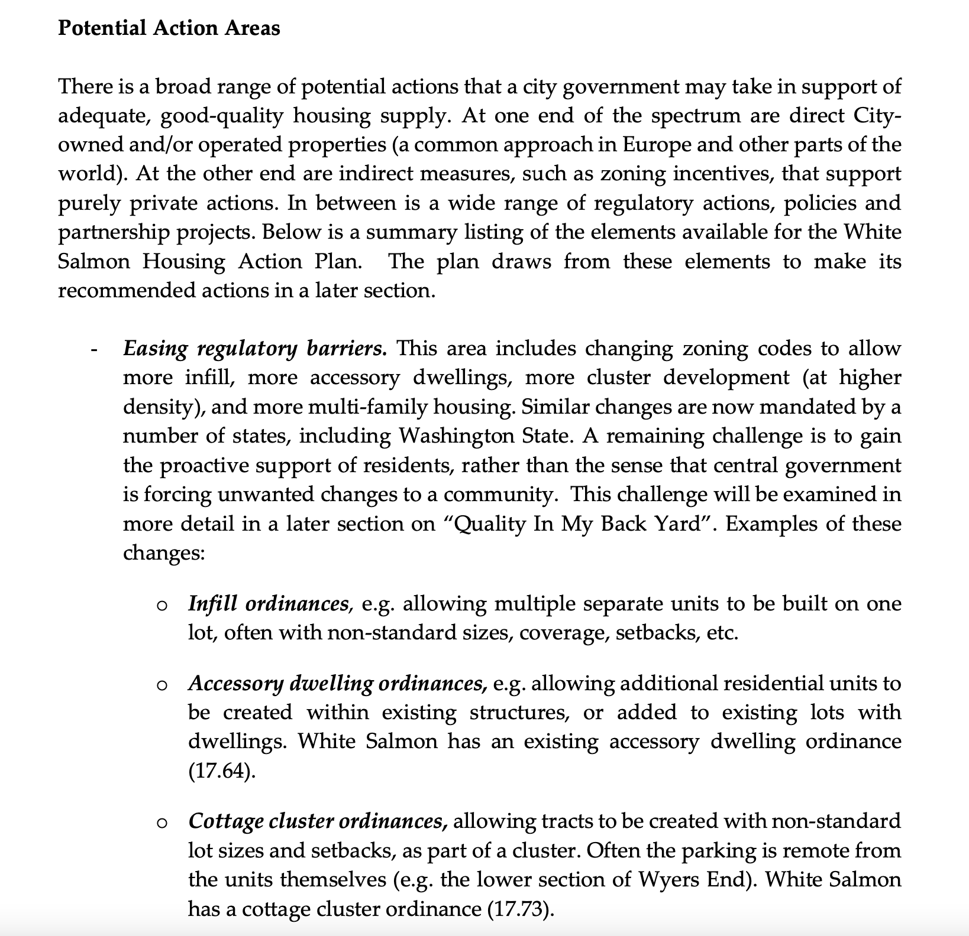
Etc…
As outlined
In memo…

Slide 54
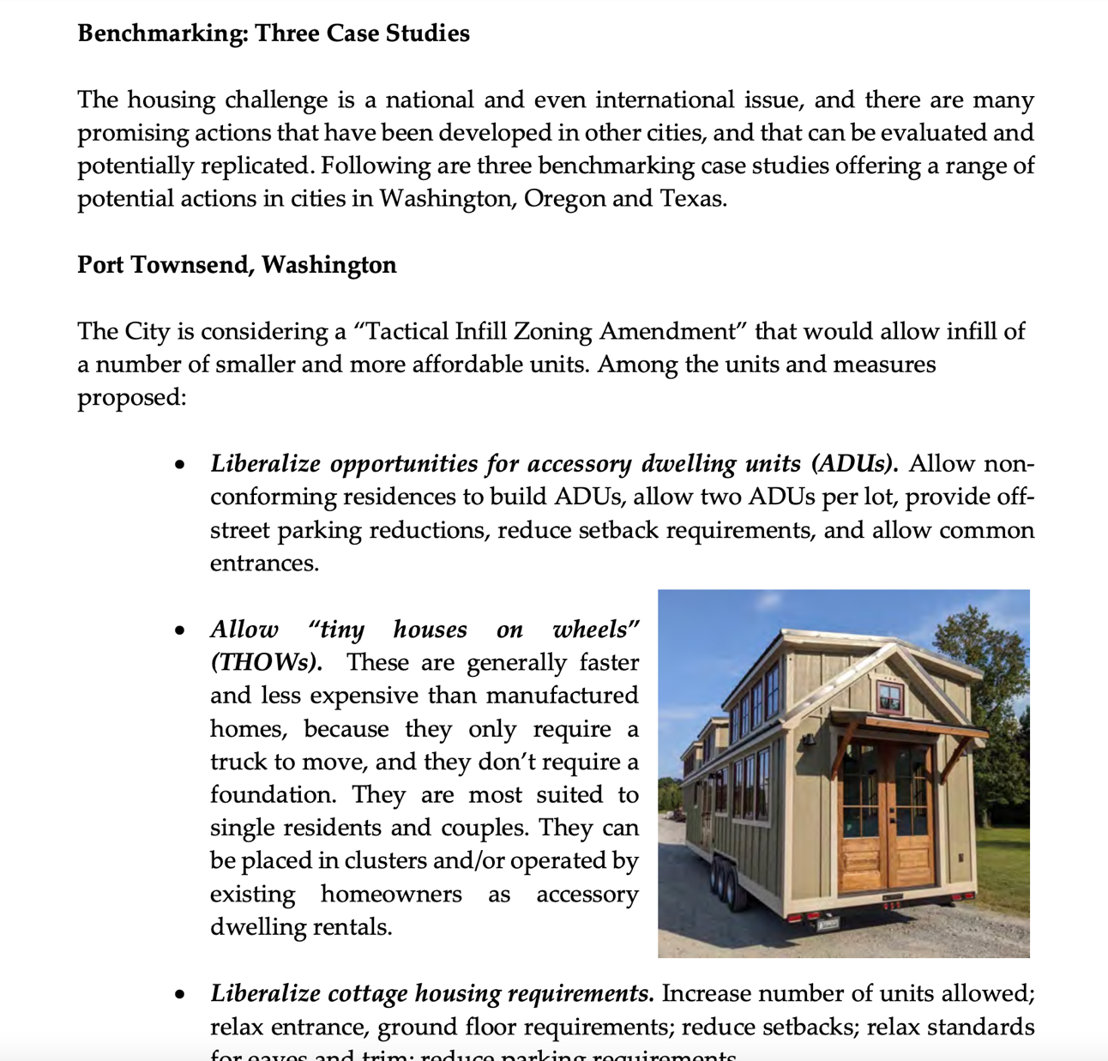

Slide 55
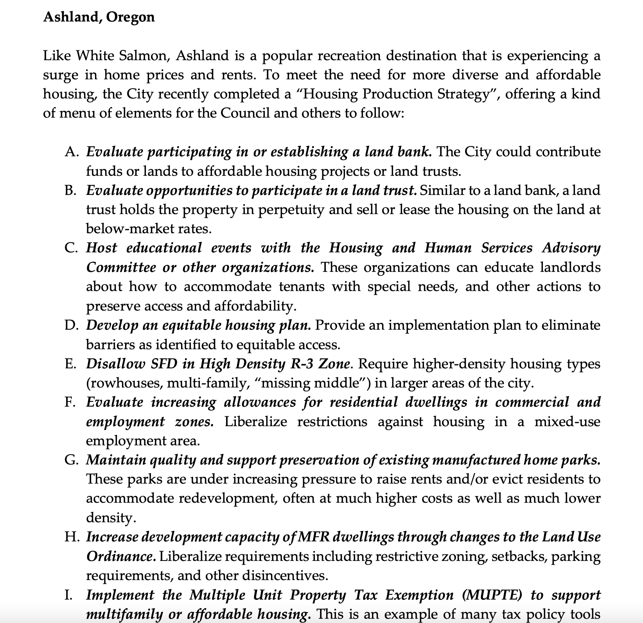
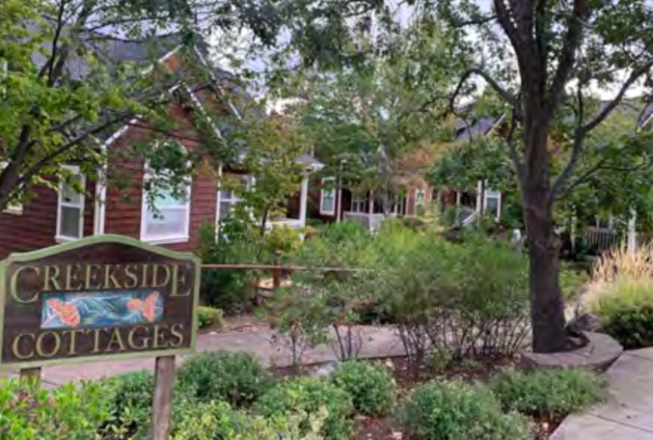
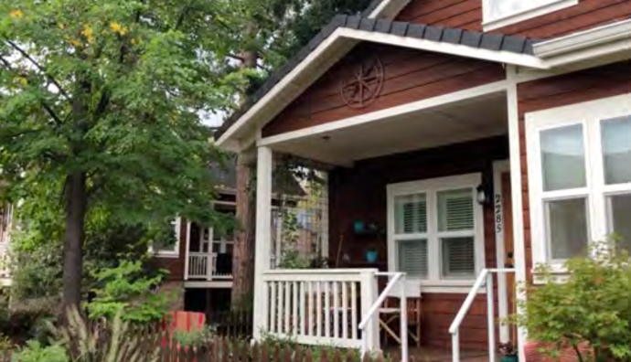

Slide 56
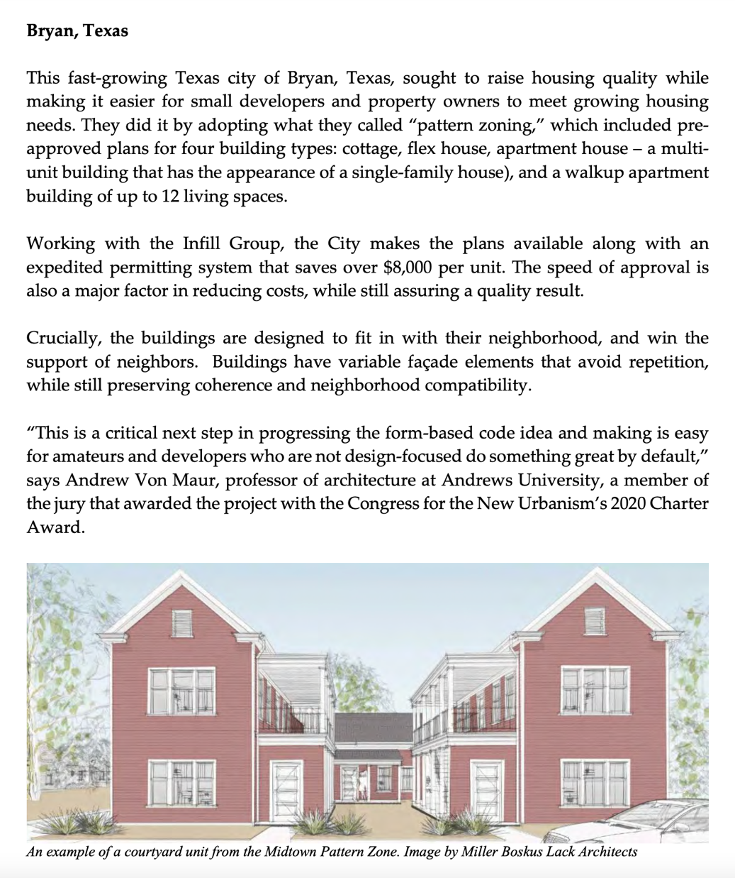
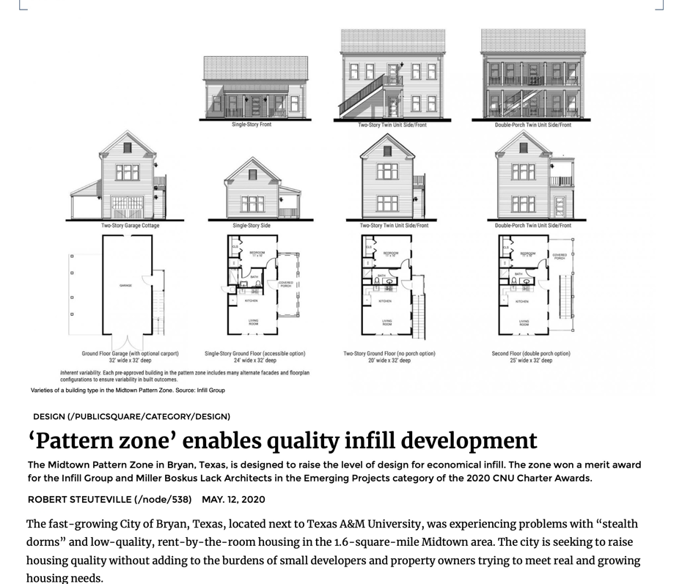

Slide 57
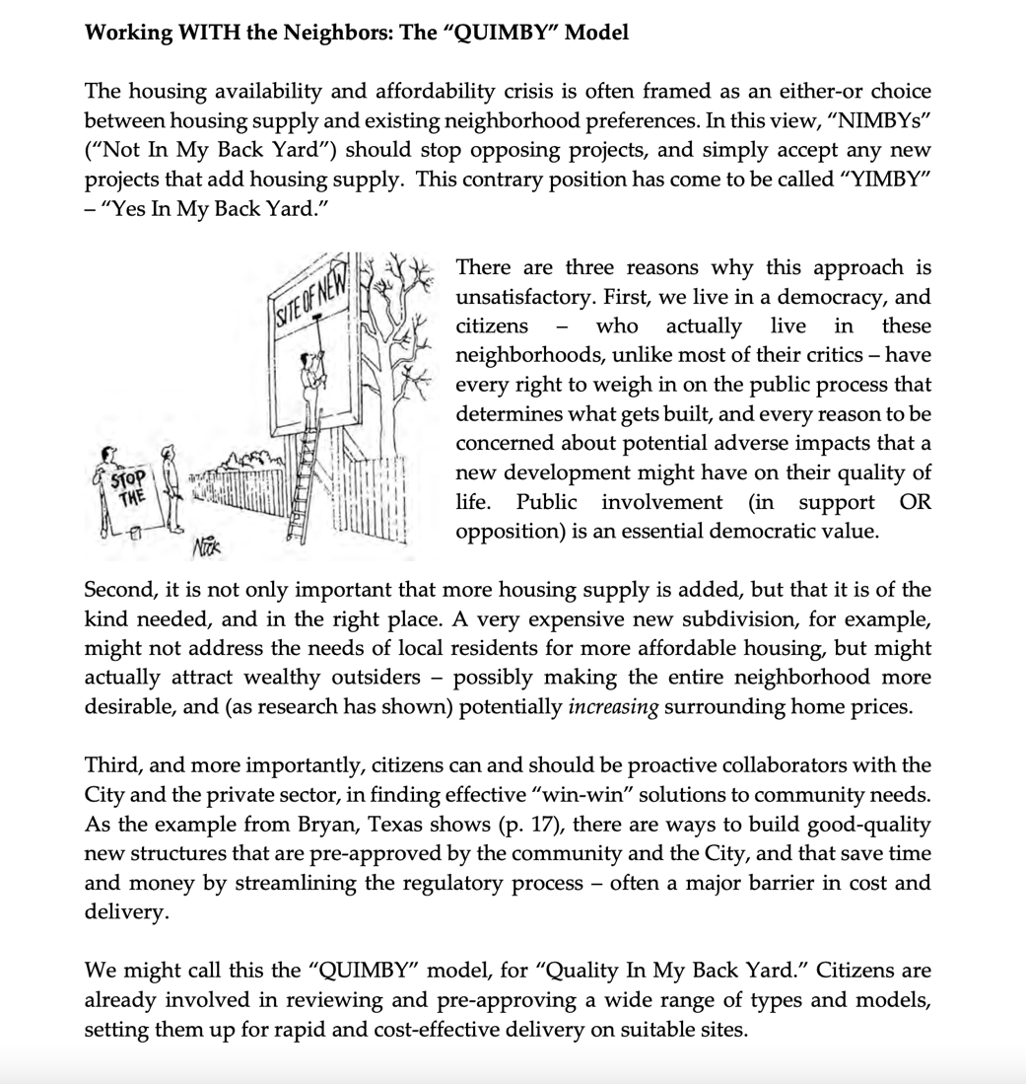
QUIMBY: “Quality In My Back Yard…”
Get early buy-in for the best win/win outcomes… preserving livability and small-town character, AND adding diverse housing at lower cost, with a streamlined process that removes barriers…

Slide 58
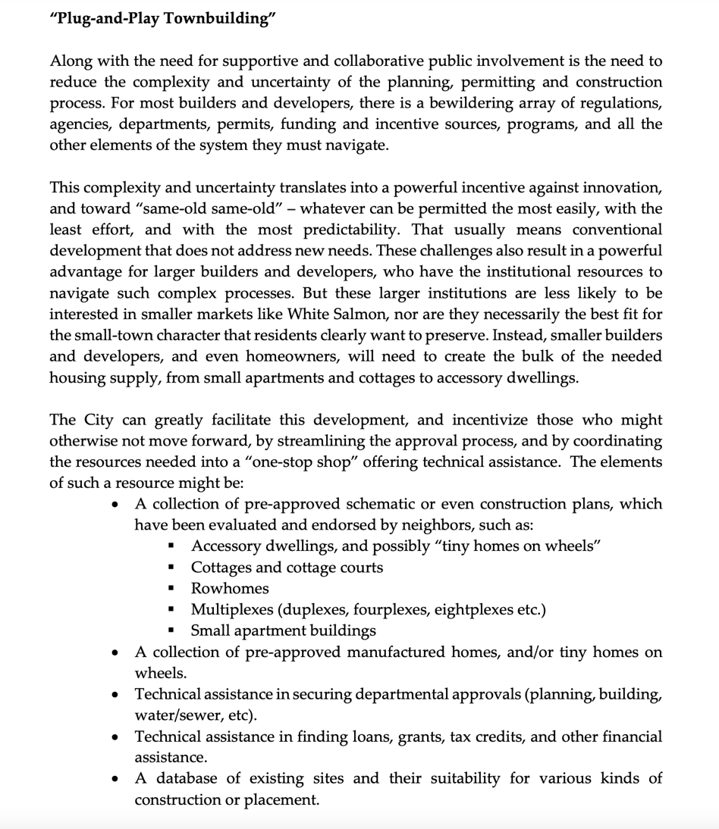
Related to that is “Plug-and-Play Townbuilding” – as in Bryan, have shovel-ready plans, types, models, assistance to produce the housing that residents need and neighbors support, on sites that are made ready for development.

Slide 59
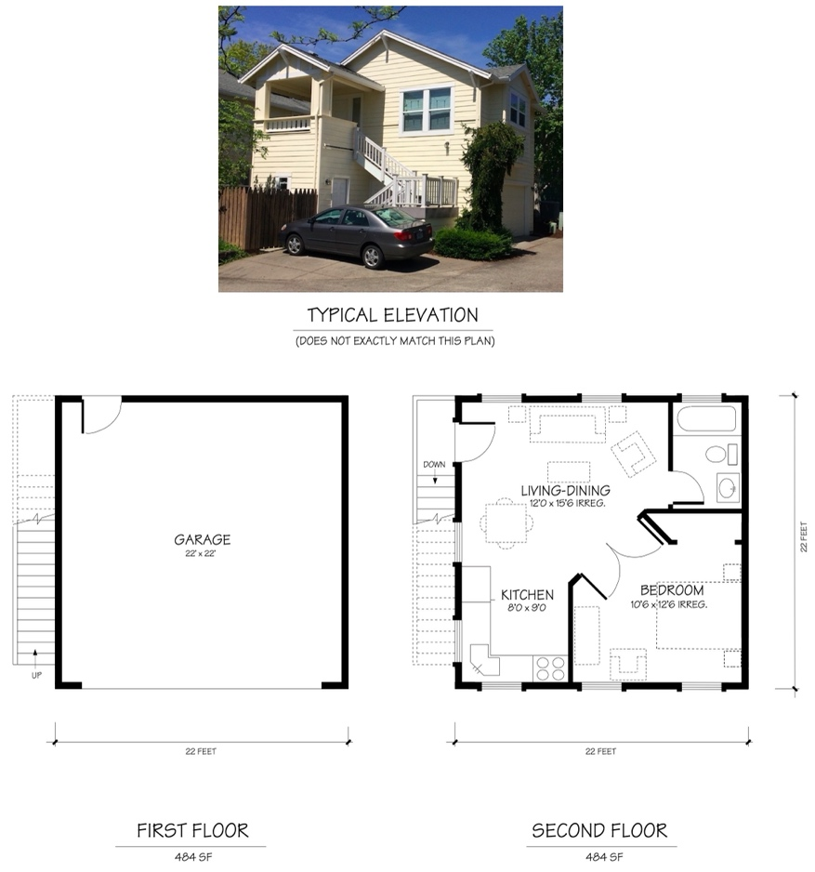
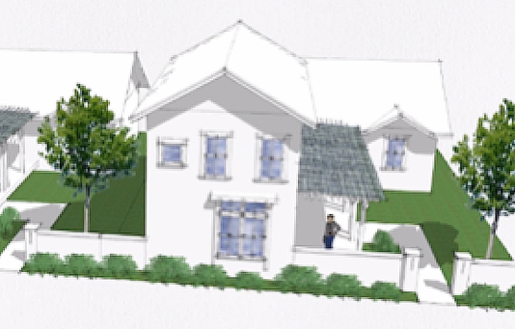
Accessory Dwelling Plans Cottage, Court Plans
NOTE: Plans by Structura Naturalis Inc., Qamar and Associates Inc., and/or Ross Chapin Architects

Slide 60
Small Rowhome Plans Small Apartment Plans
NOTE: Plans by Structura Naturalis Inc. and/or Qamar and Associates Inc.

Slide 61
INNNOVATIVE HOUSING TYPES
Featured at the HUD Innovative Housing Showcase, Capitol Mall, June 9-12
Panelized, 3-D Printed, etc…
Manufactured
Tiny House on Wheels

Slide 63
Great models already here to evaluate…
Cottage court
Larger cottage

Slide 64
Great models already here to evaluate…
Live-above retail – new and adaptive reuse…

Slide 65
Great models already here to evaluate…
Duplex (rowhouse)
Small apartments (7 units)

Slide 66
Great models already here to evaluate…
Modern condo
Modern condo

Slide 67
Great models already here to evaluate…
Modern duplex
Modern home

Slide 68
Great models already here to evaluate…
Traditional home
Traditional home

Slide 69
Sites to compile and recruit
(with landowners and neighbors)…

Slide 70
“Pattern language” process…
Establish a shared vision first
“The acclaimed Pattern Language process... engages people at an earlier and higher level, asking them to describe a location’s unique qualities and values; to imagine a sense of place, and types of use, before anyone even thinks about streets, parking, or buildings—something you just don’t get with a traditional approach.”
- Lt. Col. Skip Novakovich, Chair, Port of Kennewick Commission

Slide 71
“Pattern language” process…
Establish a shared vision first

Slide 72
“Pattern language” process…
Establish a shared vision first

Slide 73
Summary of Recommendations
1. Remove barriers (further) from restrictions on infill within existing residential zones, by working with neighbors to establish agreed models that increase density, reduce setbacks, lower parking standards, and maintain quality (“QUIMBY” approach).
2. Compile a database of existing and potential sites for development, and conduct a community workshop for each suitable site to develop appropriate plans and/or recruit developers.
3. Develop a form-based code for parts of the city that wish to adopt it, allowing great flexibility in use and density, but regulating the form, especially at the street.
Develop an existing housing protection ordinance, including provisions to restrict tear-downs (with exceptions for more and/or more affordable replacement units), provide incentives for upgrades, and/or tax reductions when rented at affordable rates.
Develop a Housing Trust Fund to assist with the procurement of land (and/or land trusts), pay for infrastructure and/or regulatory costs, and/or provide direct funding for the purchase and/or conversion of housing for those with special needs.
Create an office (or task an existing office) to assist with development of tax increment finance partnerships to create the necessary infrastructure for new housing projects.
Create an office (or task an existing office) to recruit and develop partnerships with existing non-profit housing institutions. Identify incentives, such as “feebates”, that will encourage these institutions to initiate projects.
Create an office (or task an existing office) to recruit market-rate developers and/or identify suitable sites for development.
Consider launching an “innovative housing festival” to showcase new ideas, and bring innovative builders to White Salmon.

Slide 74
Summary of Recommendations
4. Develop an existing housing protection ordinance, including provisions to restrict tear-downs (with exceptions for more and/or more affordable replacement units), provide incentives for upgrades, and/or tax reductions when rented at affordable rates.
5. Develop a Housing Trust Fund to assist with the procurement of land (and/or land trusts), pay for infrastructure and/or regulatory costs, and/or provide direct funding for the purchase and/or conversion of housing for those with special needs.
6. Create an office (or task an existing office) to assist with development of tax increment finance partnerships to create the necessary infrastructure for new housing projects.
Create an office (or task an existing office) to recruit and develop partnerships with existing non-profit housing institutions. Identify incentives, such as “feebates”, that will encourage these institutions to initiate projects.
Create an office (or task an existing office) to recruit market-rate developers and/or identify suitable sites for development.
Consider launching an “innovative housing festival” to showcase new ideas, and bring innovative builders to White Salmon.

Slide 75
Summary of Recommendations
7. Create an office (or task an existing office) to recruit and develop partnerships with existing non-profit housing institutions. Identify incentives, such as “feebates”, that will encourage these institutions to initiate projects.
8. Create an office (or task an existing office) to recruit market-rate developers and/or identify suitable sites for development.
9. Consider launching an “innovative housing festival” to showcase new ideas, and bring innovative builders to White Salmon.

Slide 76
Thank you!

